Slide 1
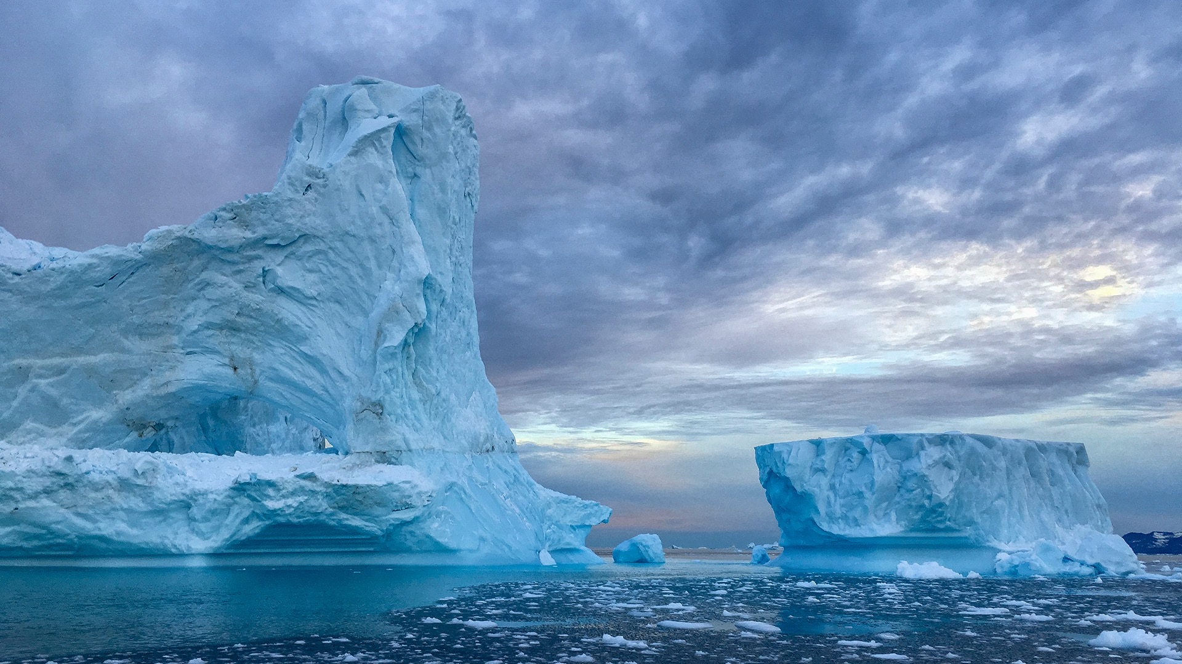

Ice breakers
Virtual activities
to start your meetings or training sessions
Activities imagined by
Jorj Helou
Leadership Awakener
Please share…
Get inspired and remember to adapt the activities
to your context and to your needs

Slide 2



Slide 3
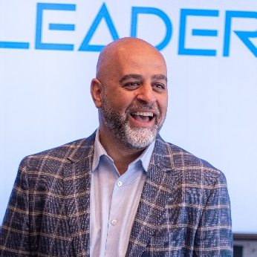
Speaker
Leadership Awakener
Trainer
Instructional designer
20+ years of experience in skills development
Coach, ICF certified
Educational background in business administration & management
+ banking & finance
Jorj Helou CHRP, PCC

Slide 4
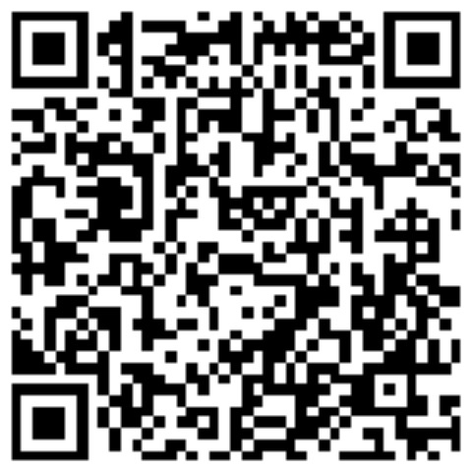
Jorj Helou CRHA, PCC
Leadership Awakener
https://leaderzone.ca/
Contact@LeaderZone.ca
Speak soon!

Slide 5
Jorj Helou CRHA, PCC
Leadership Awakener
https://leaderzone.ca/
Contact@LeaderZone.ca
Speak soon!

Slide 6
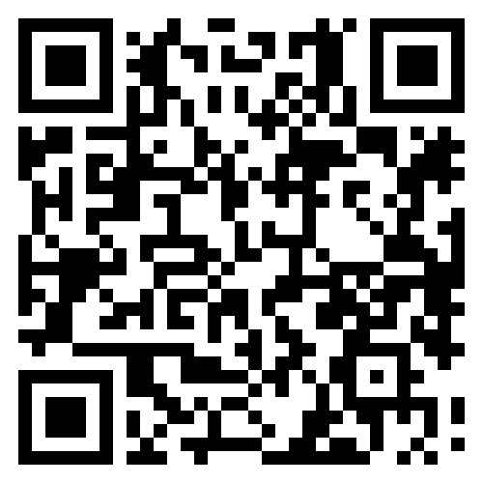
Jorj Helou CHRP, PCC
Leadership Awakener
https://leaderzone.ca/
Contact@LeaderZone.ca
https://leaderzone.ca/en/diagnostic/
Diagnostic is a tool for reflection,
a free mini-questionnaire
monthly published by LeaderZone,
to enable you to recalibrate your leadership
Speak soon!

Slide 7
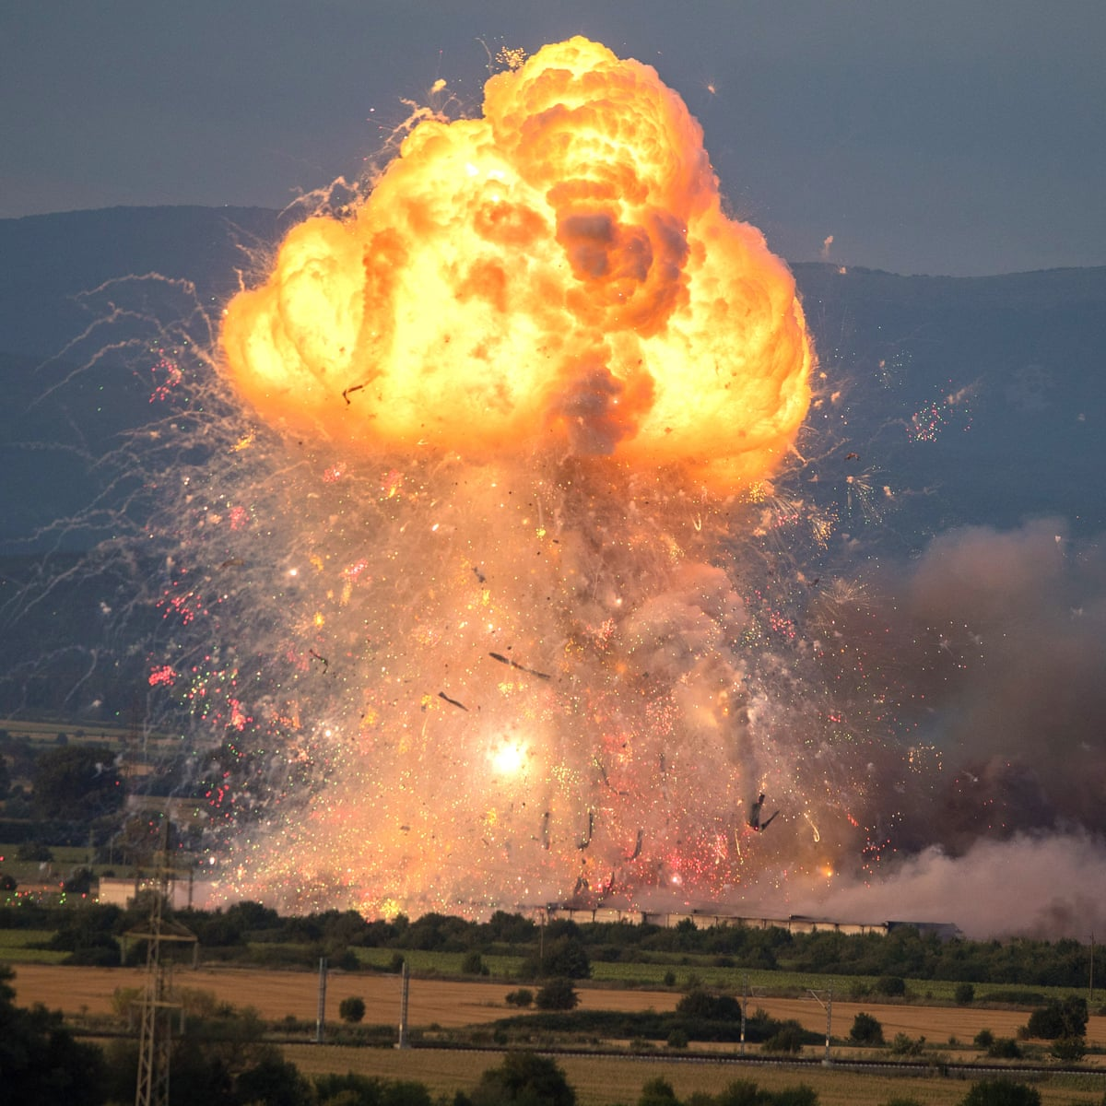

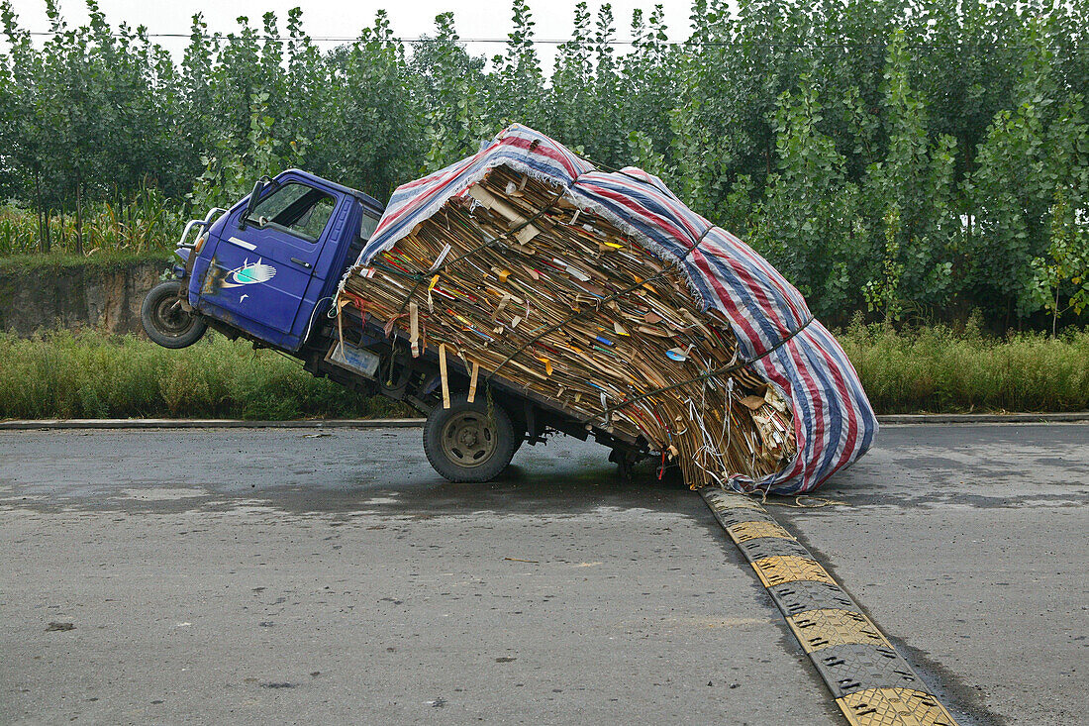

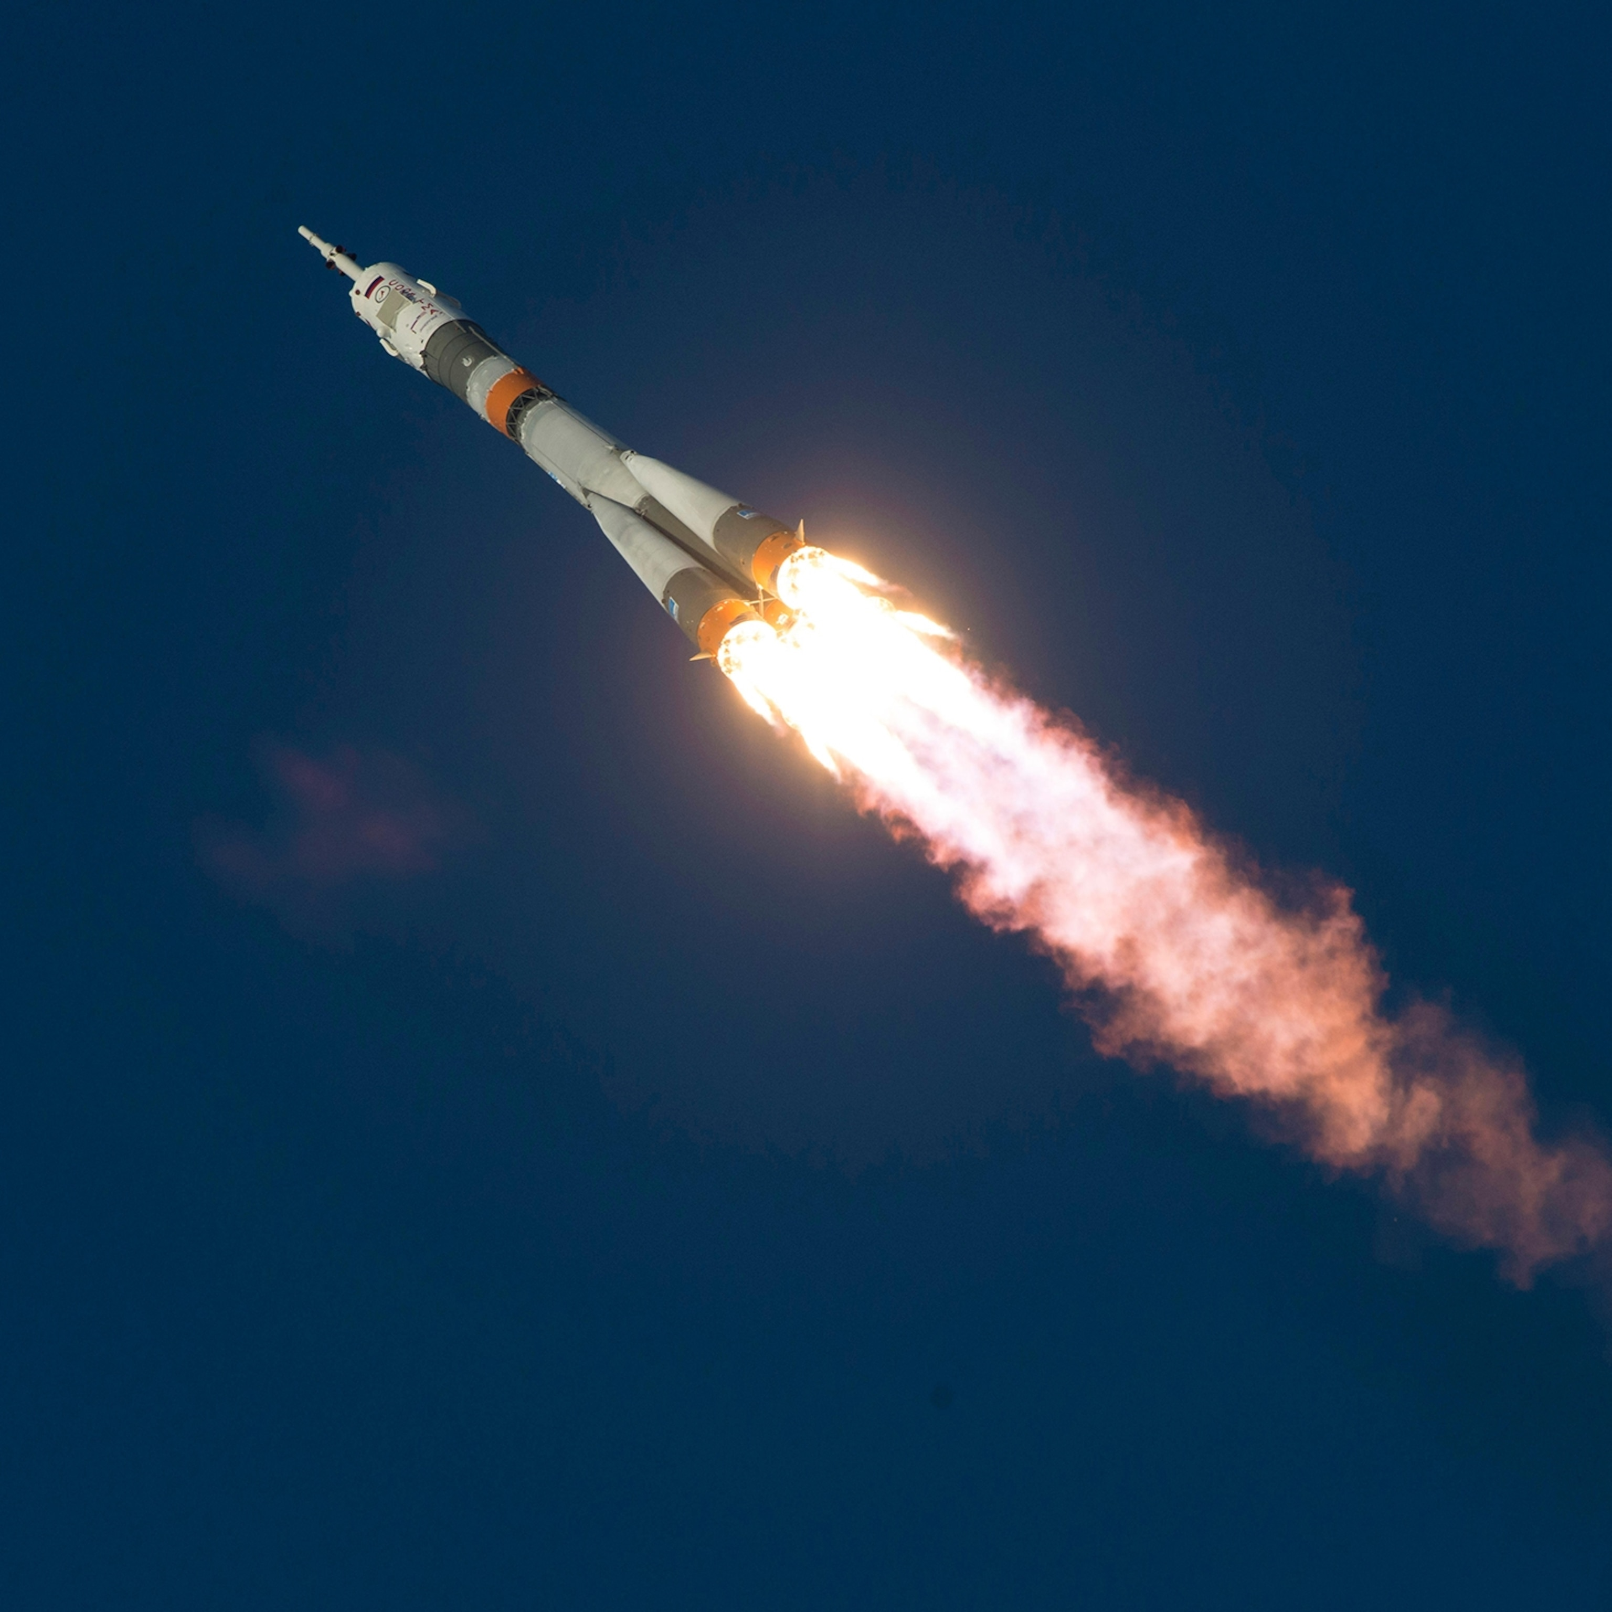
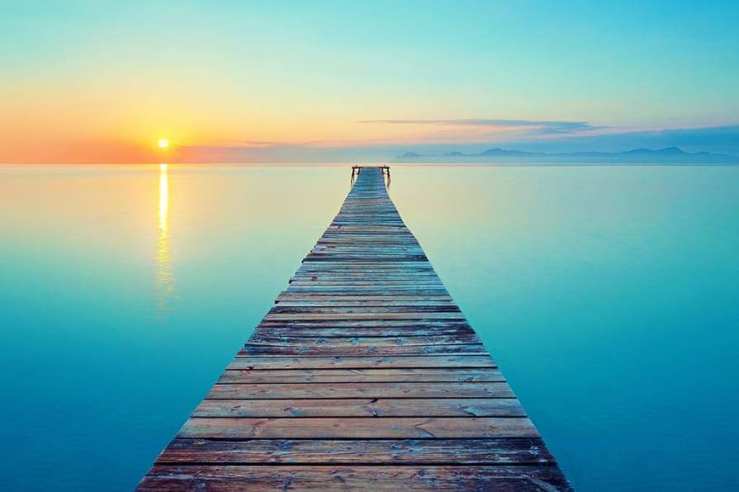
Get inspired by an image and create an analogy
“Impactful presentations are like...”

Slide 8

What’s your superpower? What’s your kryptonite?

Slide 9

How’s the weather inside?

Slide 10

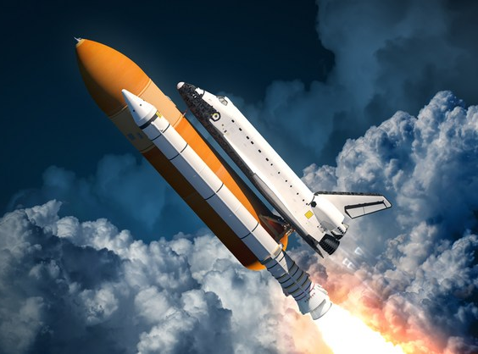
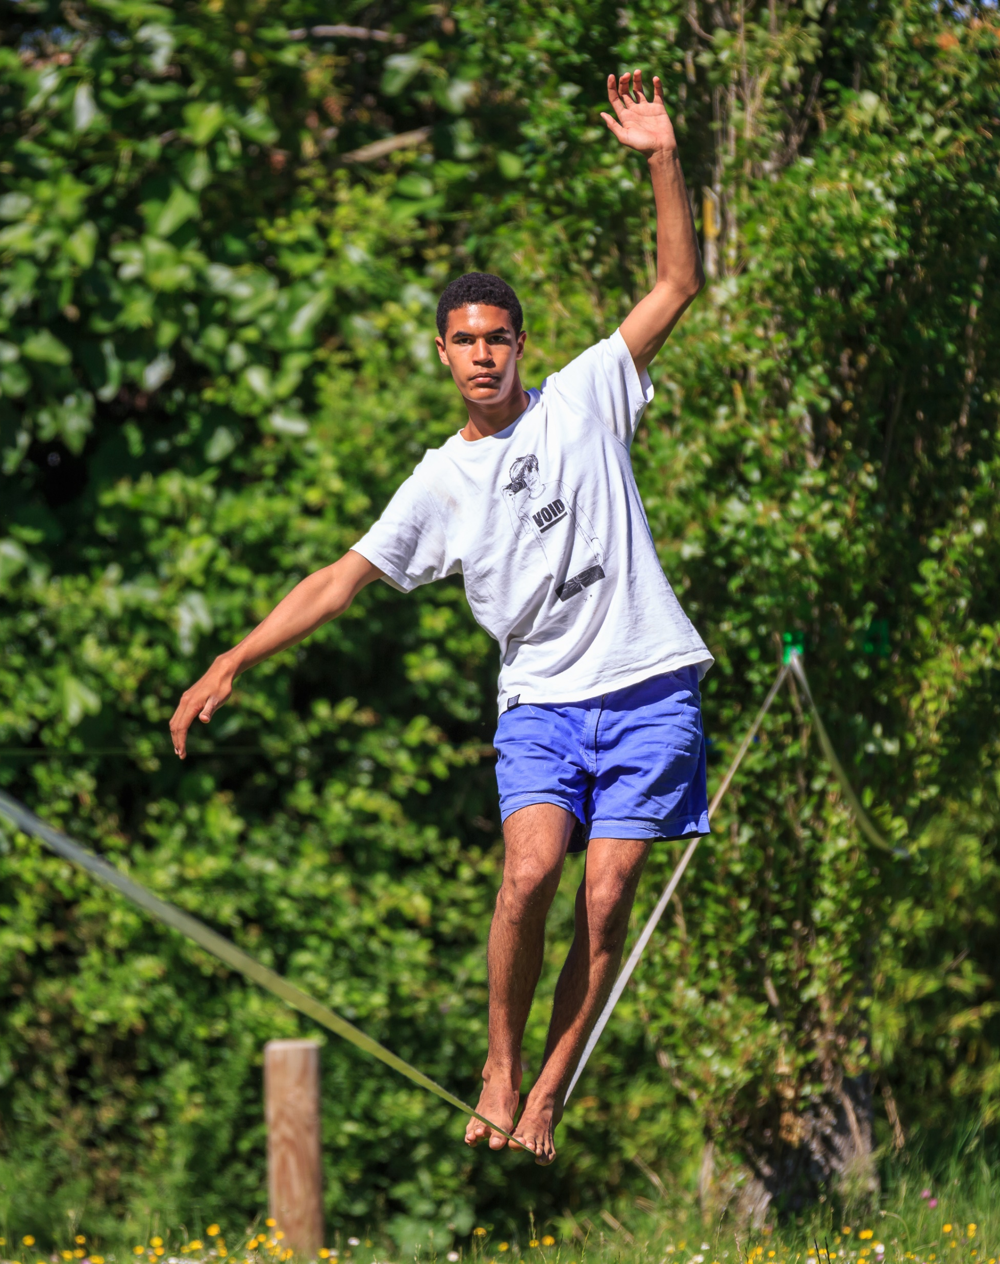
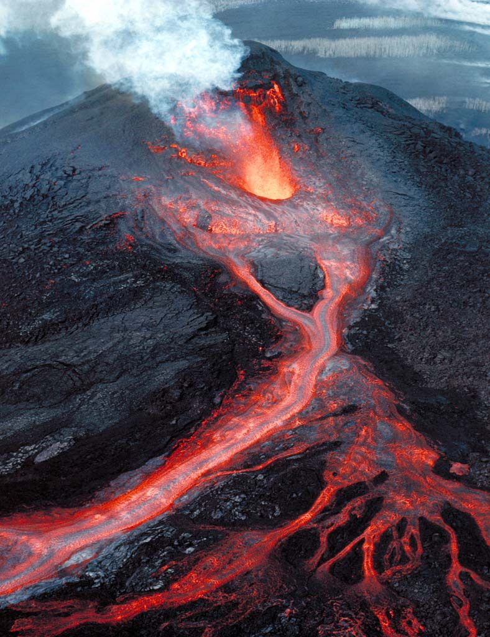
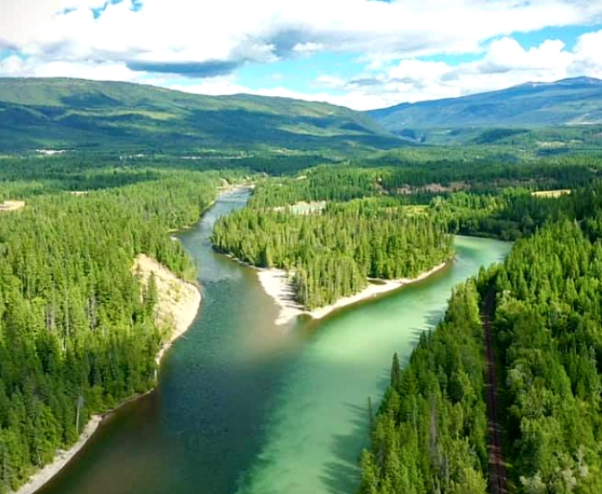

Get inspired by an image and create an analogy
“Time management is like...”

Slide 11
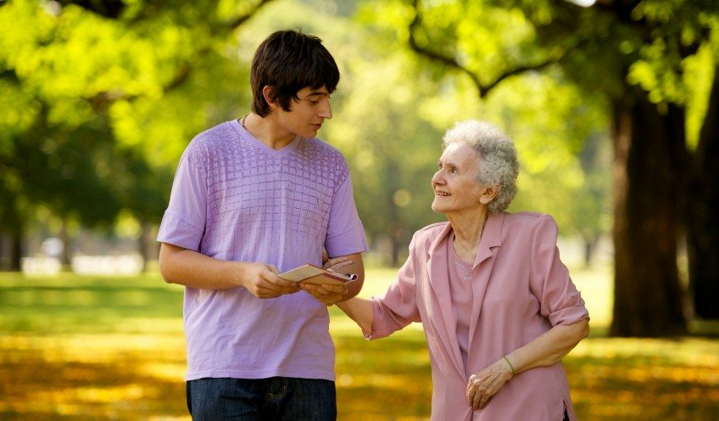
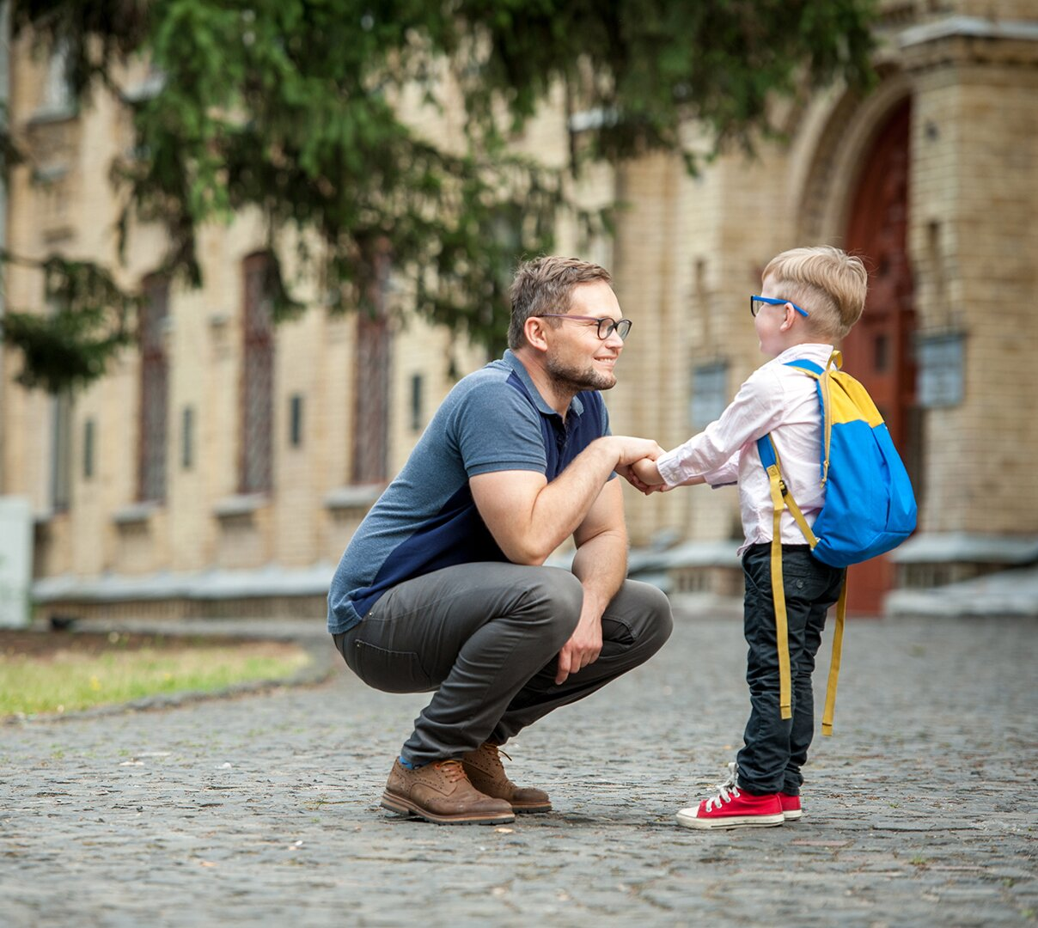

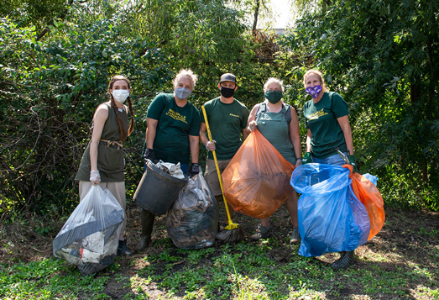
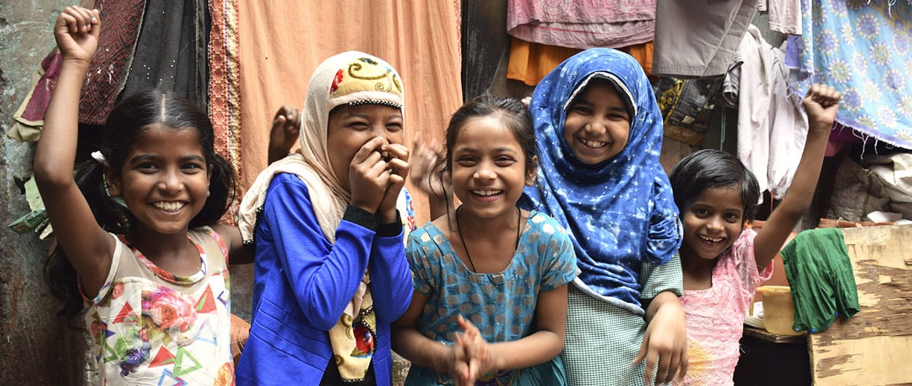
Choose a pic, name an emotion, a value or an inspiration
1
2
3
4
5

Slide 12
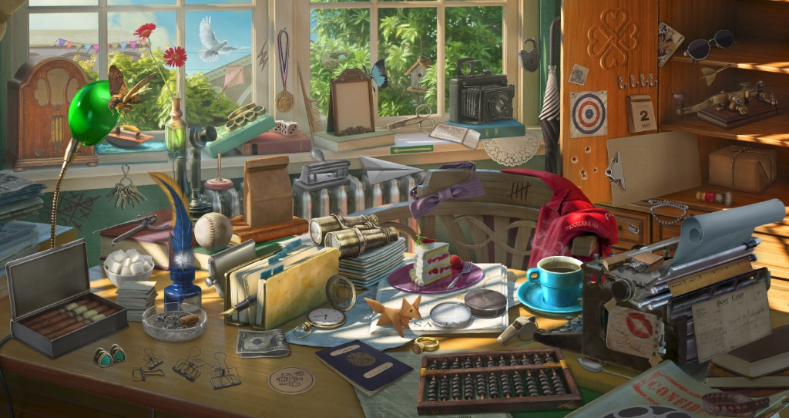
Choose an object and tell us about your choice

Slide 13
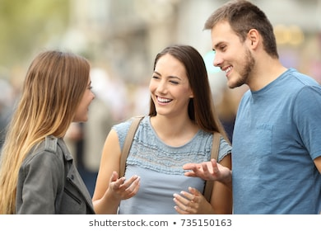
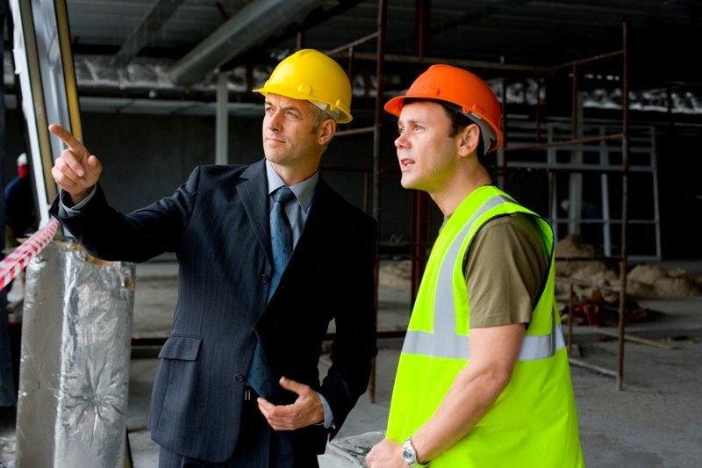
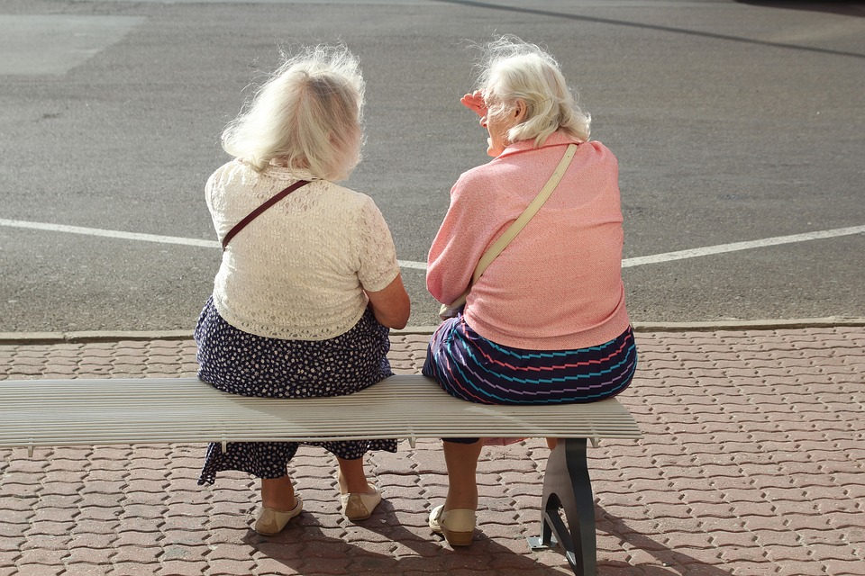
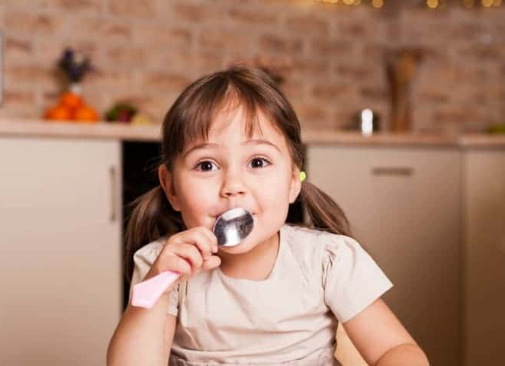
A
B
C
D
E
F
G
H
What are they saying? What are they thinking of?

Slide 14
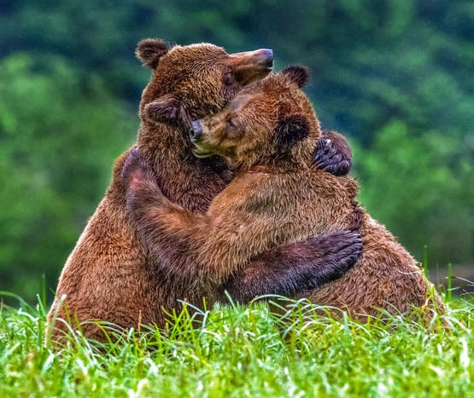
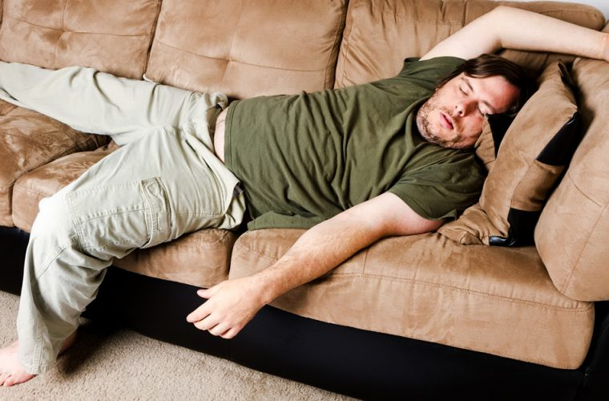
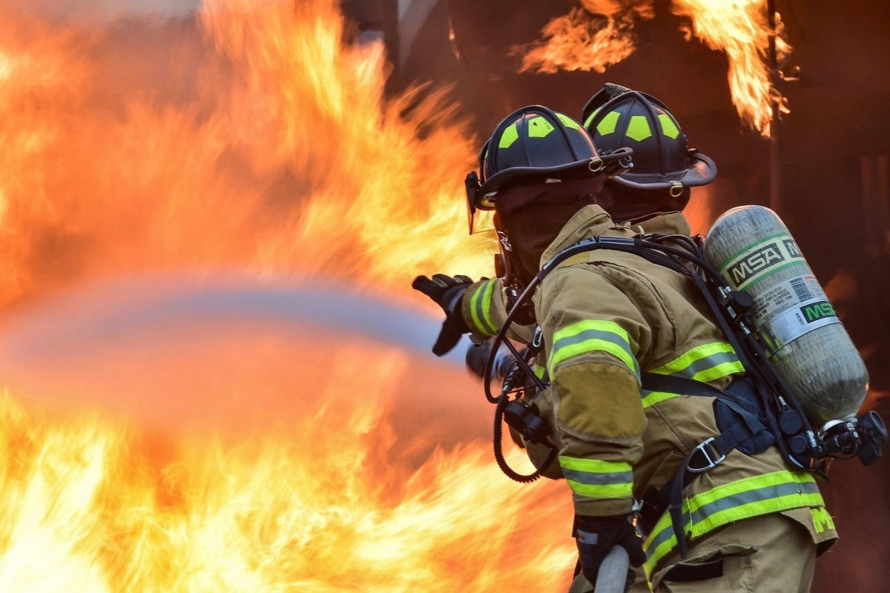
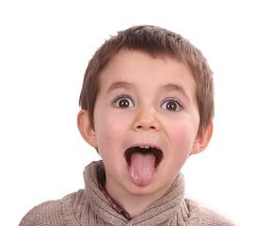


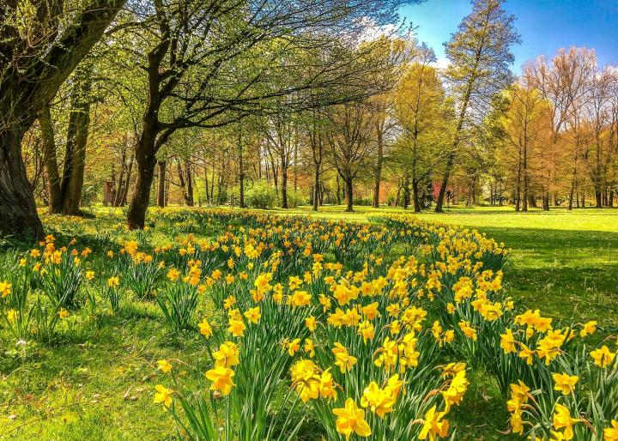
Which picture is the most representative of your mood today?

Slide 15
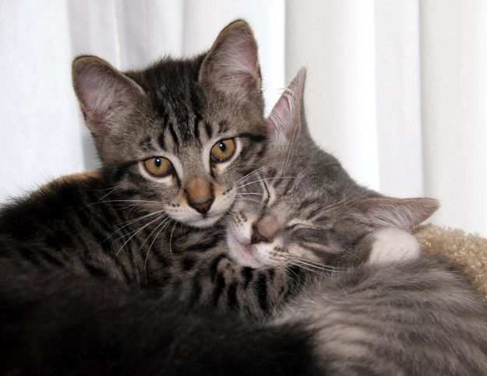
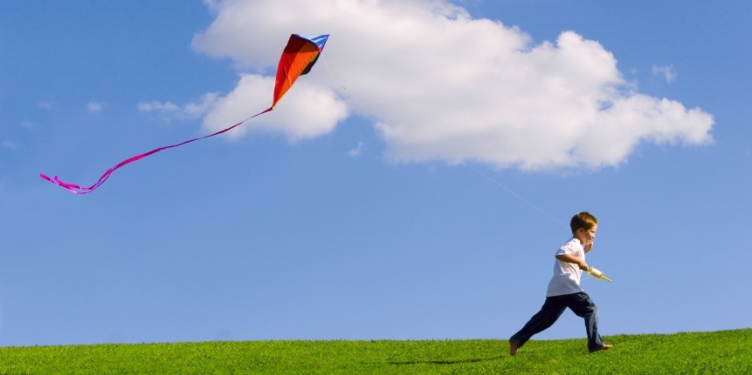
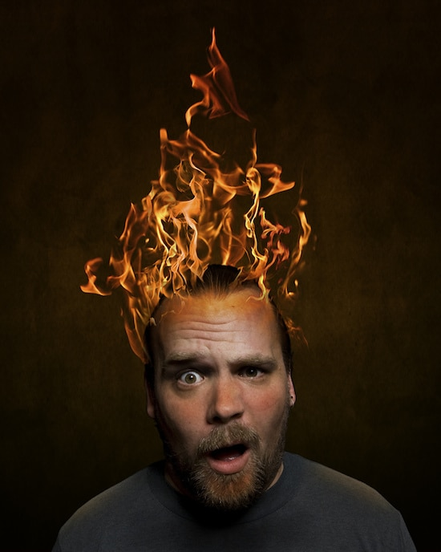


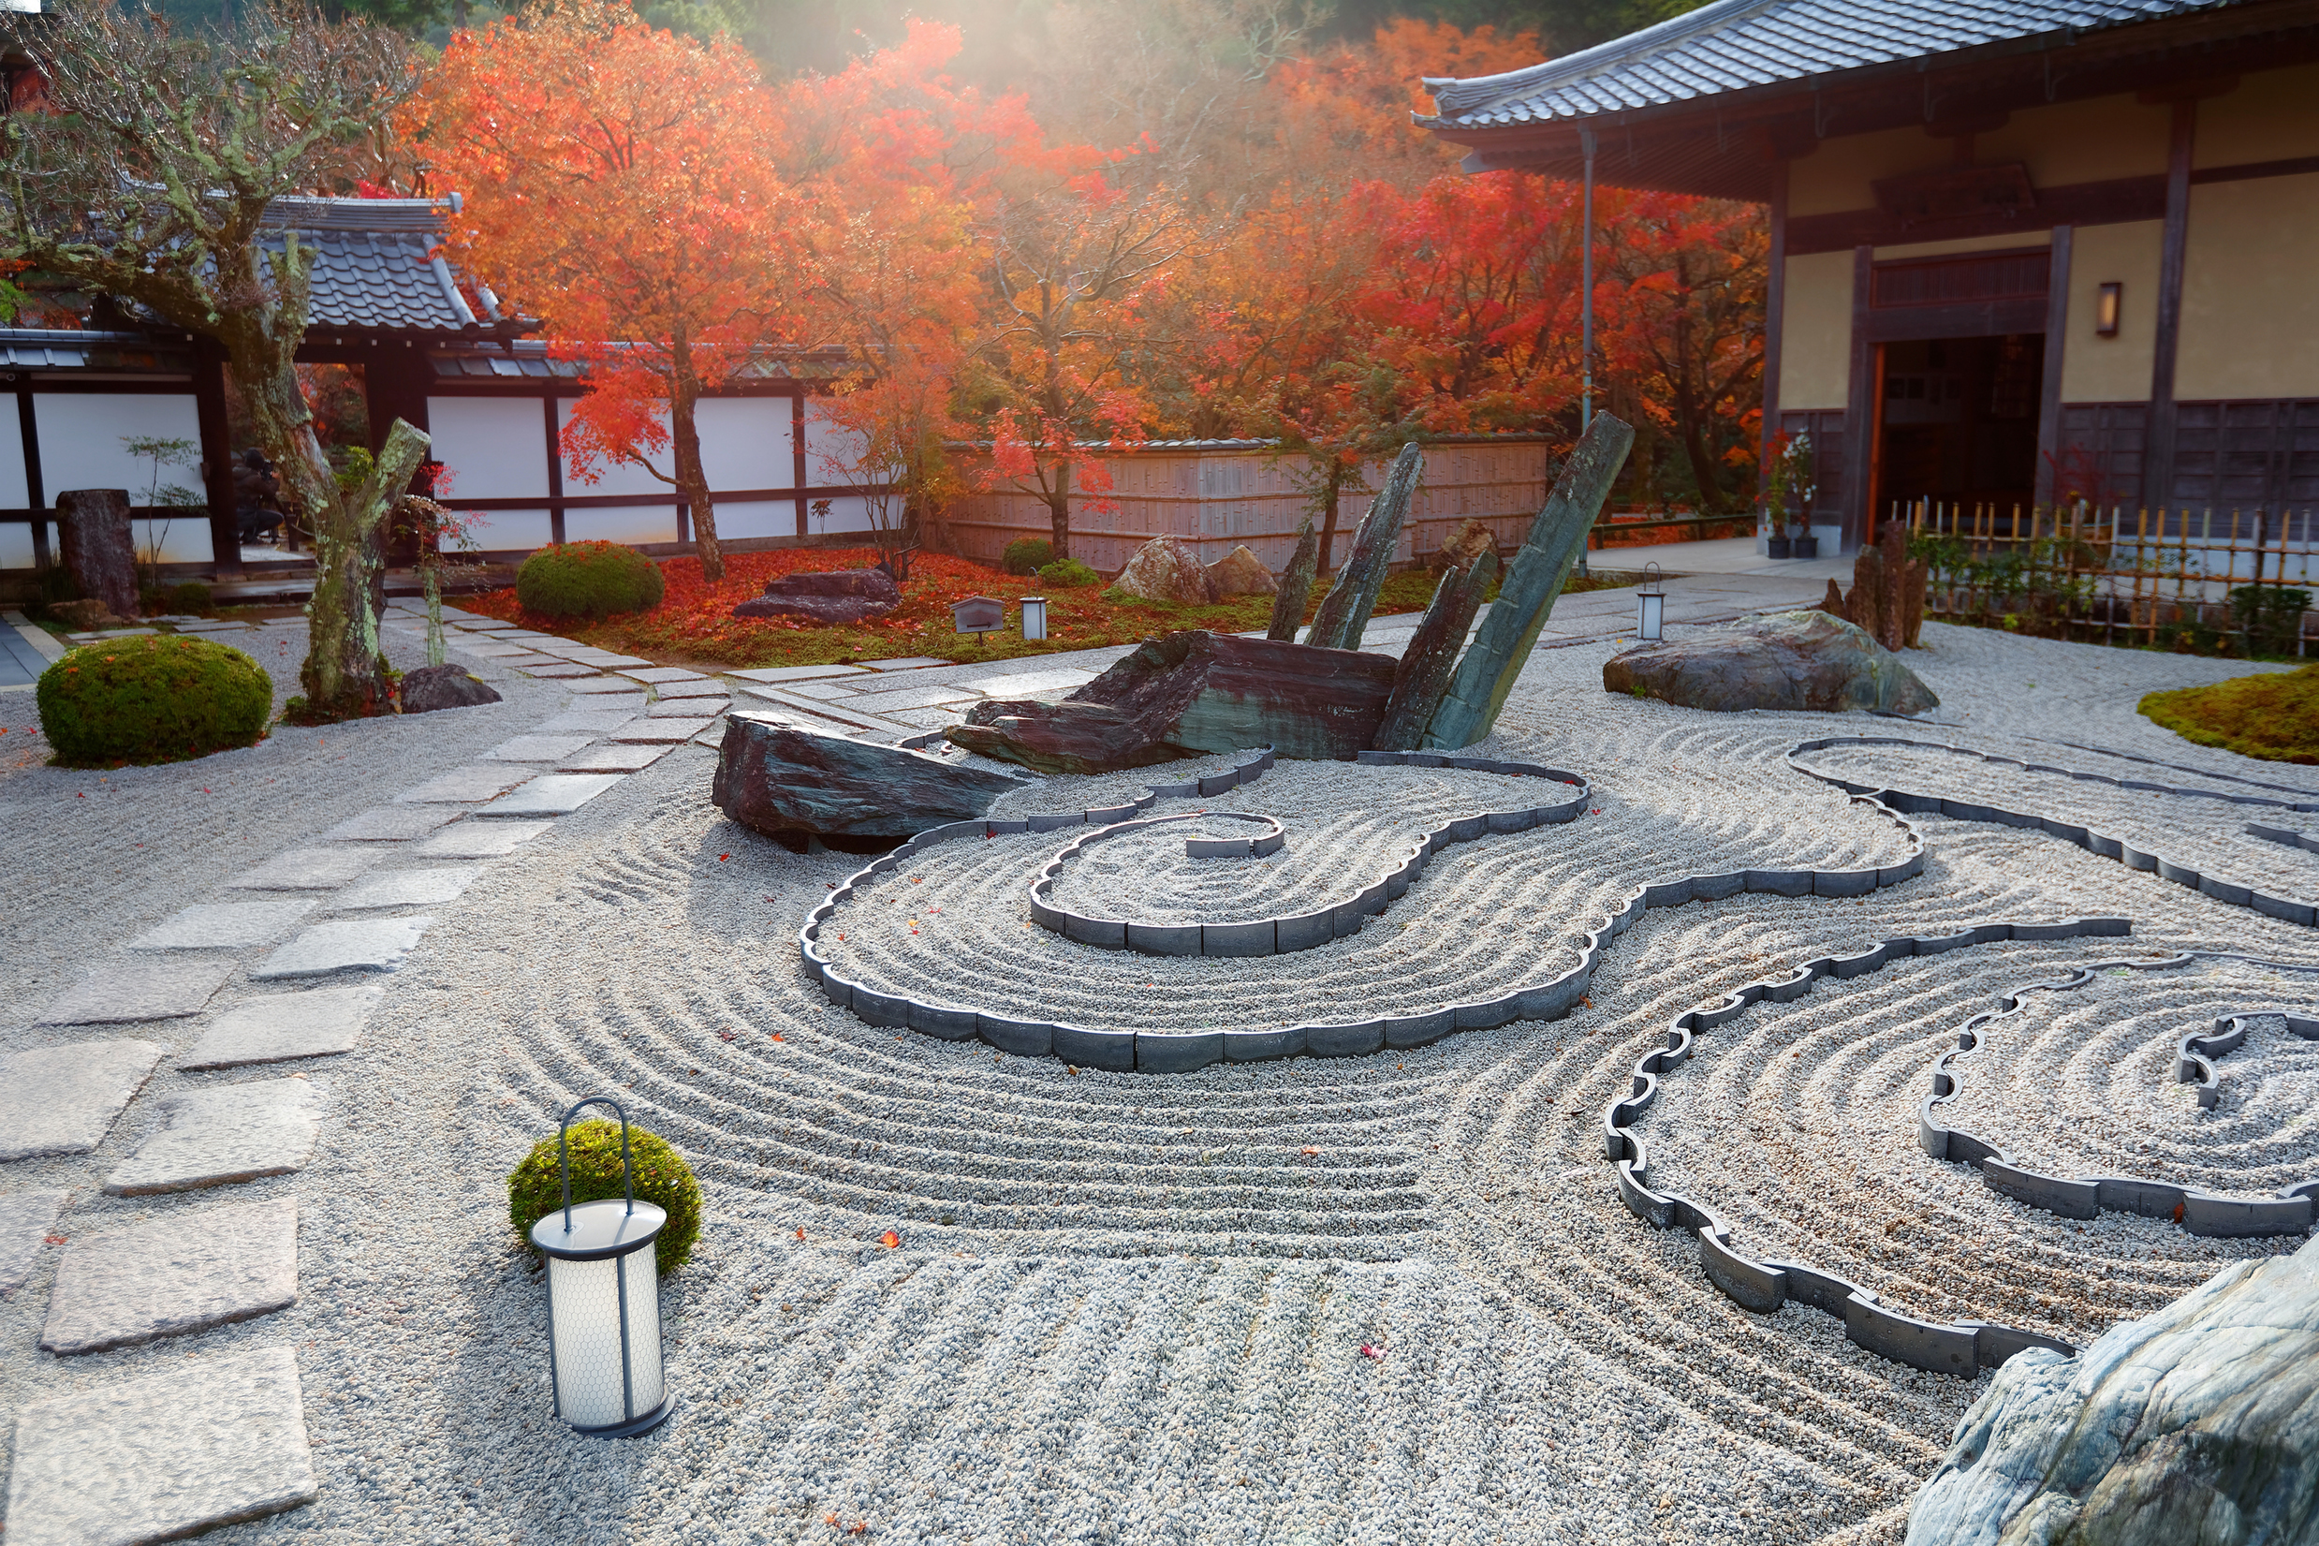
Which picture is the most representative of your mood today?
Notes:
Partage à micros ouverts

Slide 16

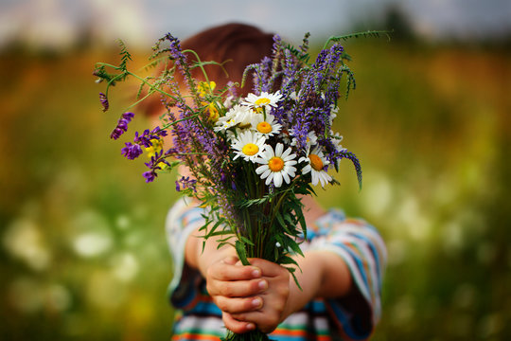

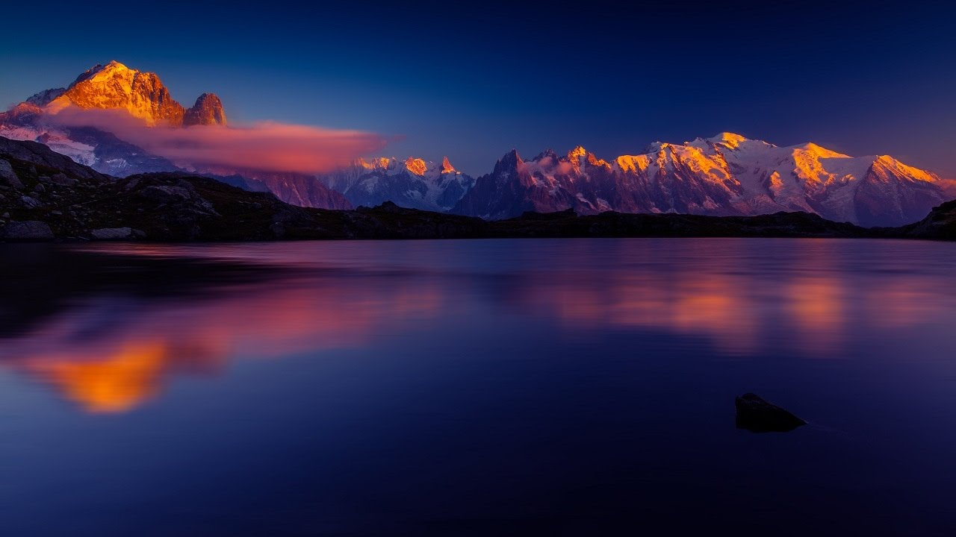
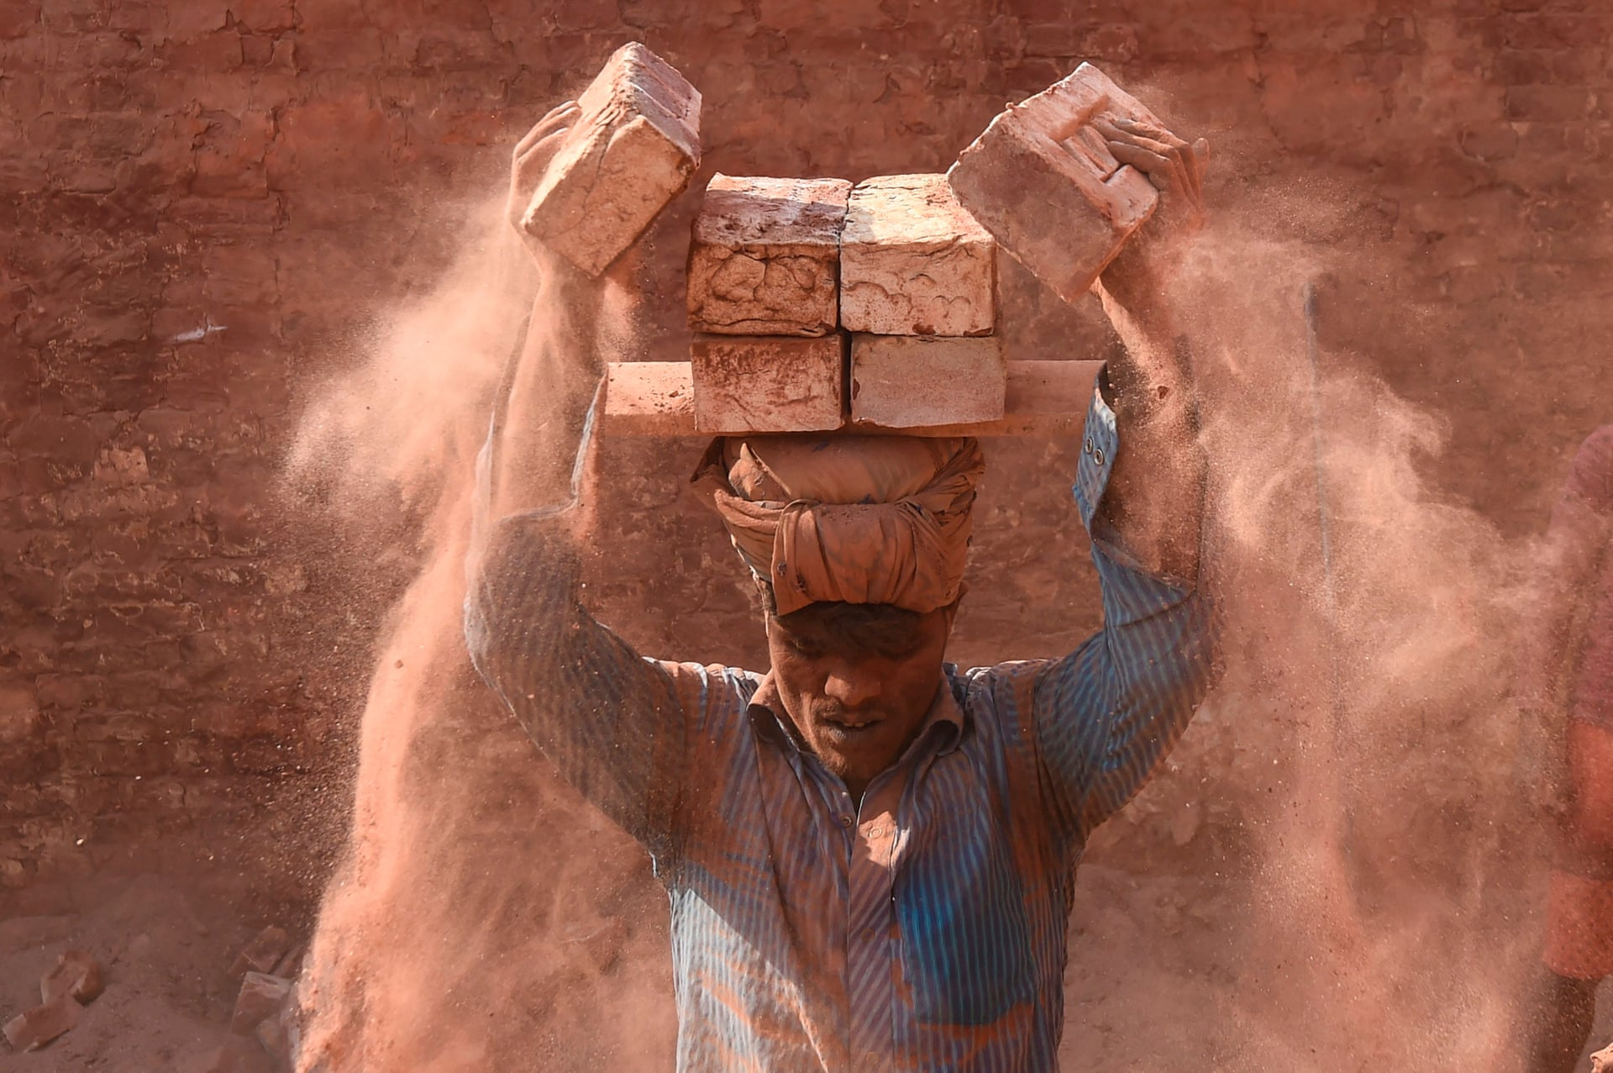
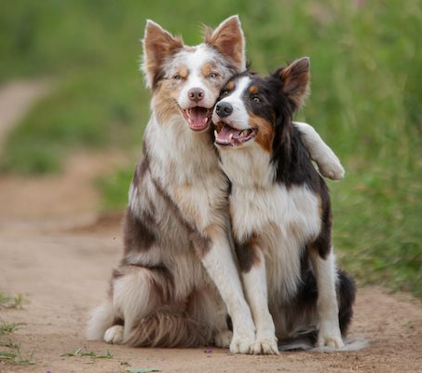
Which picture is the most representative of your mood today?
Notes:
Partage à micros ouverts

Slide 17
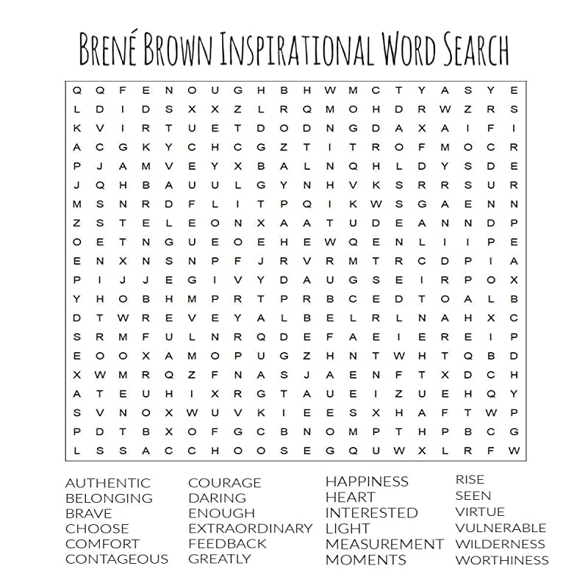
CONTAGIOUS
Notes:
Use the annotation tools

Slide 18
What’s the first word you see and how does it inspire you today?
Brené Brown’s inspirational word search
Notes:
Use the annotation tools

Slide 19
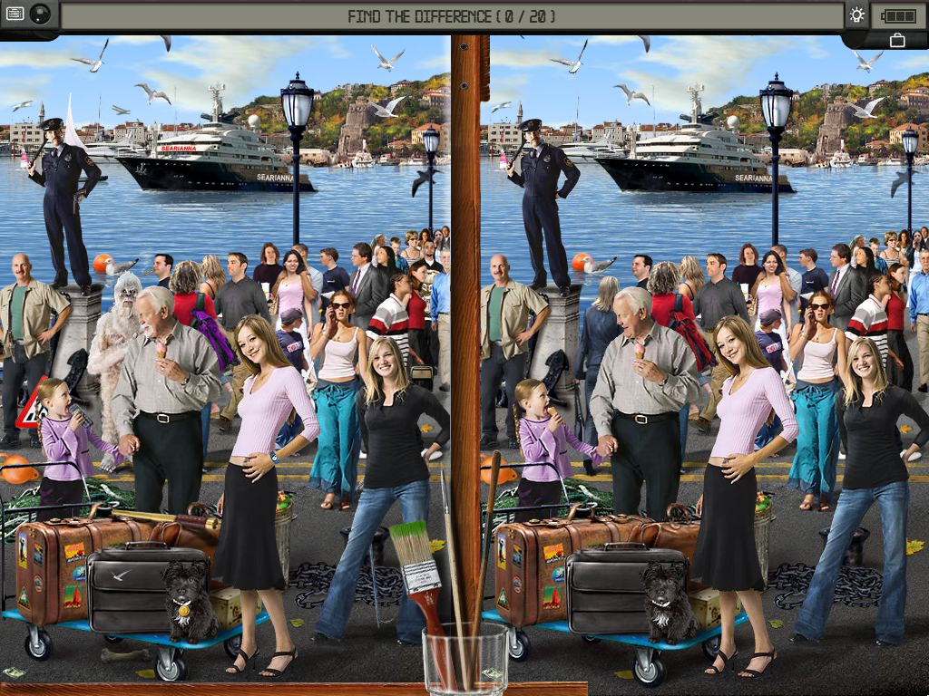
find
20 differences
Notes:
Use the annotation tools

Slide 20
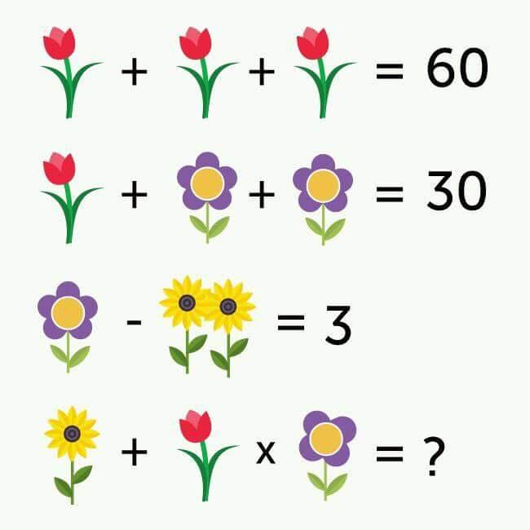
Can you solve it?
Notes:
One red tulip = 20.
A purple flower with 5 petals = 5 (so a purple flower with 4 petals = 4)
2 sunflowers = 2 (so one sunflower = 1).
The last line: there is 1 sunflower (therefore 1) + a red tulip (therefore 20) x a purple flower with 4 petals (therefore 4). 1 + 20x4.
We must first multiply 20x4 and add 1. This gives 81.

Slide 21
Which quote inspires you the most today and why?
"Let excellence be your brand...
Doing the right thing, even when nobody knows you're doing the right thing, will always bring the right thing to you.“
– Oprah Winfrey
"Teamwork begins by building trust. And the only way to do that is to overcome our need for invulnerability." – Patrick Lencioni
"Talent wins games, but teamwork and intelligence win championships." – Michael Jordan
“The courage to be vulnerable is not about winning or losing, it’s about the courage to show up when you can’t predict or control the outcome.”
– Brené Brown
"It is literally true that you can succeed best and quickest by helping others to succeed.“
– Napolean Hill

Slide 22

If children live with criticism,
they learn to condemn.
If children live with hostility,
they learn to fight.
If children live with fear,
they learn to be apprehensive.
If children live with pity,
they learn to feel sorry
for themselves.
If children live with ridicule,
they learn to feel shy.
If children live with jealousy,
they learn to feel envy.
If children live with shame,
they learn to feel guilty.
If children live with encouragement, they learn confidence.
If children live with tolerance,
they learn patience.
If children live with praise,
they learn appreciation.
If children live with acceptance,
they learn to love.
If children live with approval,
they learn to like themselves.
If children live with recognition,
they learn it is good to have a goal.
If children live with sharing,
they learn generosity.
If children live with honesty,
they learn truthfulness.
If children live with fairness,
they learn justice.
If children live with kindness and consideration, they learn respect.
If children live with security,
they learn to have faith in themselves and in those about them.
If children live with friendliness,
they learn the world is a nice place in which to live.
- By Dorothy Law Nolte.
Which part do you like most and why?
Notes:
Open mics

Slide 23
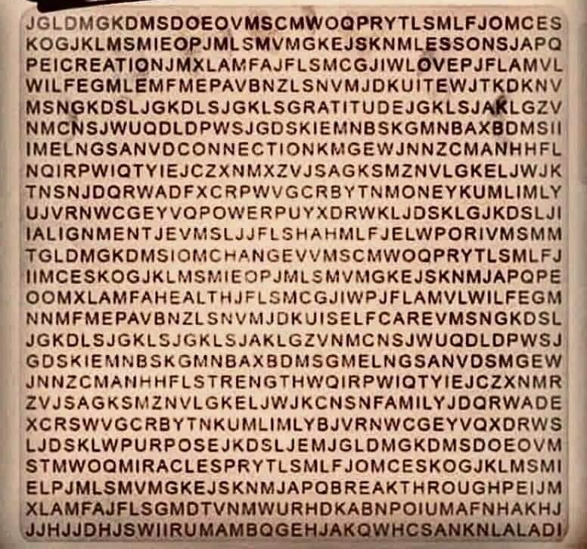
What’s the first word you see and how does it inspire you today?

Slide 24
Describe successful collaboration in words and graphics…!
Notes:
Use the annotation tools

Slide 25

Think of 3 statements about yourself (A, B & C):
2 must be true, and 1 must be false
The more unique or interesting the statement, the better! (recommended to avoid common statements like “I like ice cream”)
Each person shares the 3 statements
All vote which statement is the lie
Notes:
Use the annotation tools

Slide 26
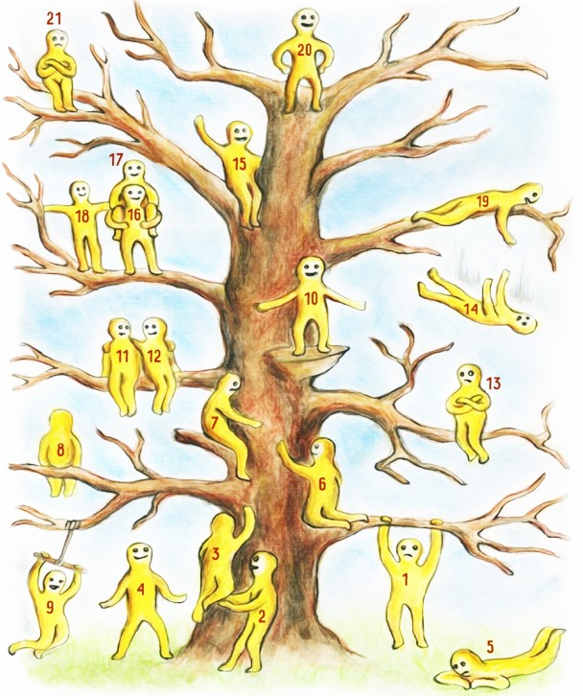
Which of the "blob" characters represents you the most in this period and why?
(inspired by Pip Willson's model)
blob 1 dares, hesitates and worries
blob 2 supports and stays secure
blob 3 gets a boost to take the first steps
blob 4 is optimistic and plans his long-term vision
blob 5 is disconnected and lets the time pass
blob 6 needs care and connection
blob 7 decides to be kind
blob 8 changes perspective, meditate or dream
blob 9 enjoys life
blob 10 celebrates success and seeks recognition
blobs 11 and 12 take the time to appreciate a friendship or a love
blob 13 is dissatisfied because he is dissatisfied
blob 14 stumbled; he should have taken it differently
blob 15 savors the moment and is not in a hurry to going further
blobs 16, 17 and 18 work as a team, support and help each other
blob 19 did everything he could to help
blob 20 is proud of achieving his goal and keeps an eye on the future
blob 21 is disappointed despite his progress

Slide 27

Create an analogy
Choose an object
Describe its characteristics, faults, benefits, dangers, uses, etc.
Make a link with the topic of this meeting

Slide 28
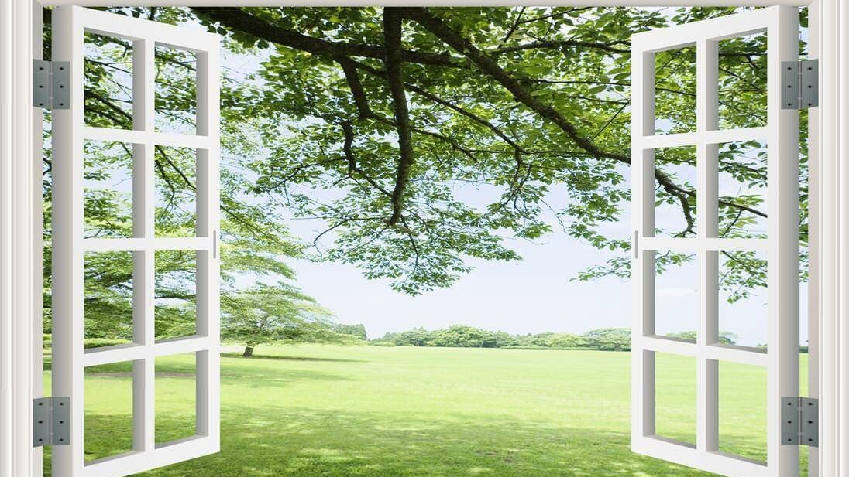
Look out your window.
What do you see? What do you appreciate?

Slide 29
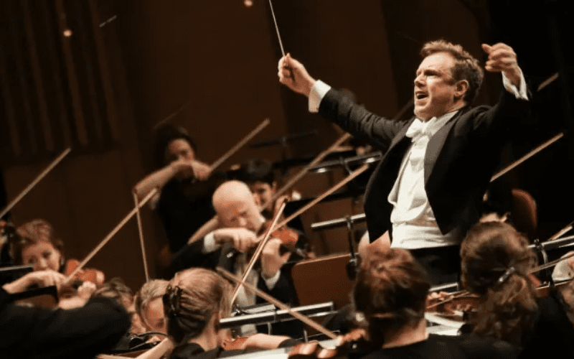
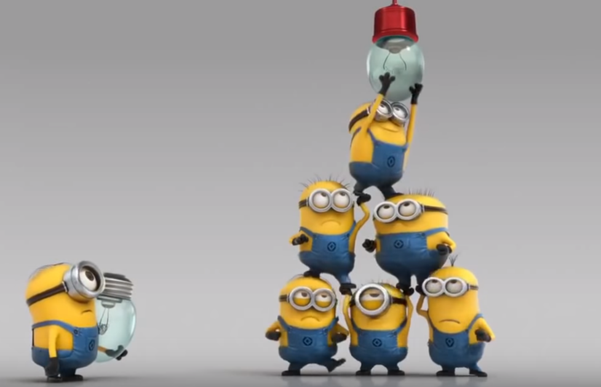
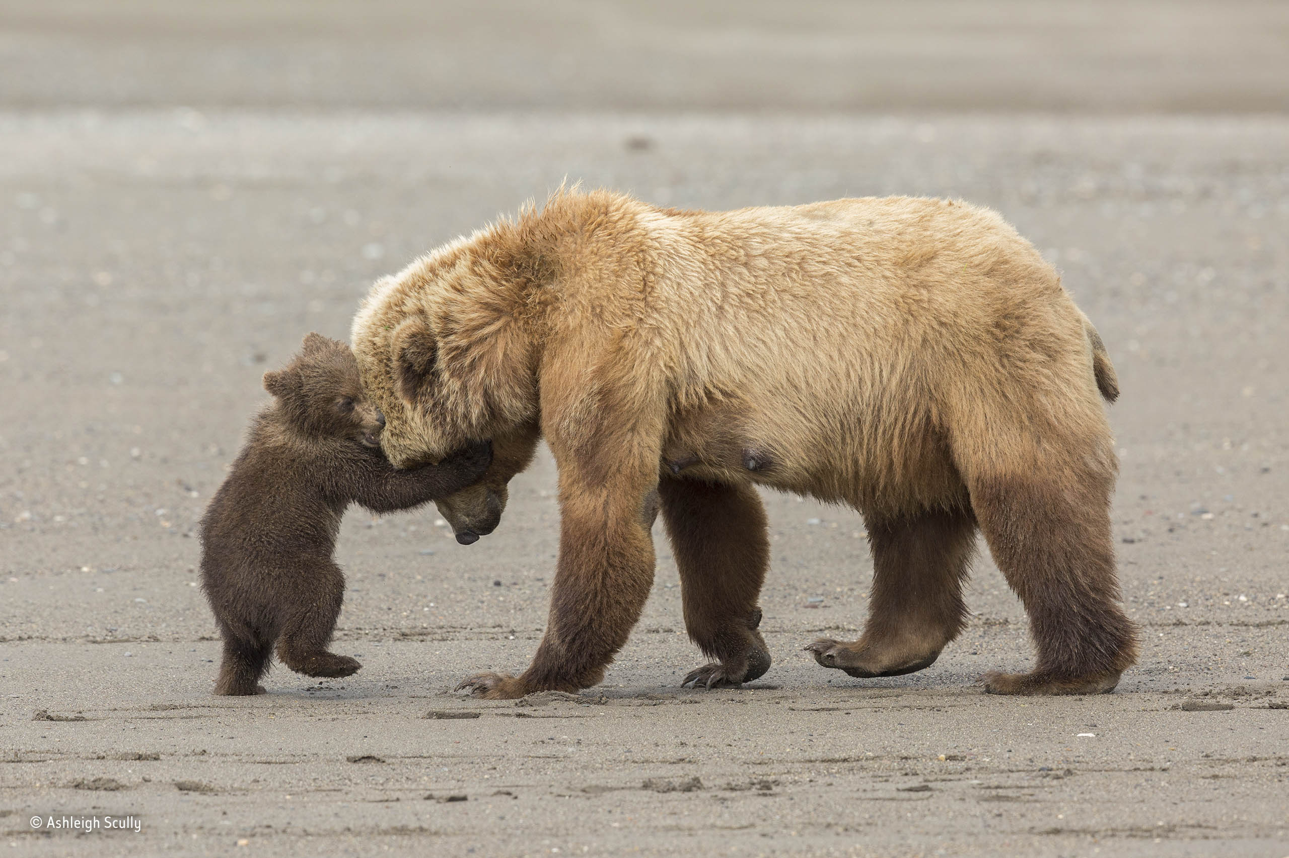
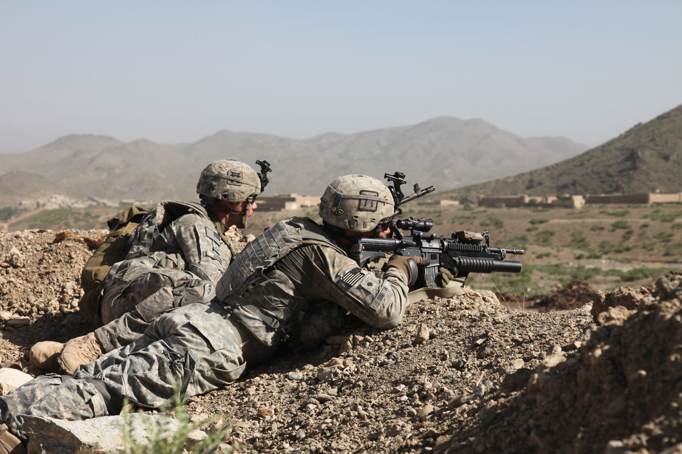

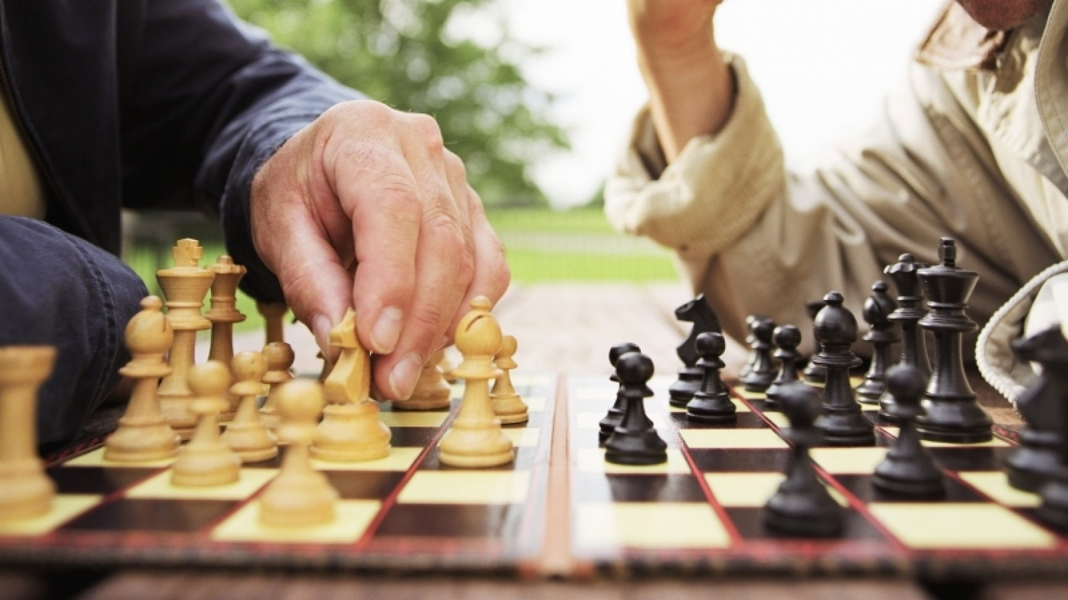
Influence is like __________ , it’s important to __________ .
Get inspired by the pics and complete the sentence with an analogy
1
2
3
4
5
6

Slide 30

Confidentially, share a surprising statement about you with the facilitator
The facilitator reads the statements without mentioning the name
Guess who?

Slide 31

Would you rather…?
Would you rather swim in a pool full of maple syrup or
a pool full of brown gravy?
Would you rather watch nothing but romantic movies or nothing but horror movies?
Would you rather go back in time and meet your ancestors or go forward in time and meet your great grandkids?
Would you rather be the funniest person or the smartest person in the room?

Slide 32


Your missions, if you accept them!
…
…
…
Notes:
Donnez 1 ou 2 minutes pour faire un plan d’action
Partager en grand groupes quelques engagements et quelques feedbacks (appréciations) sur l’atelier

Slide 33
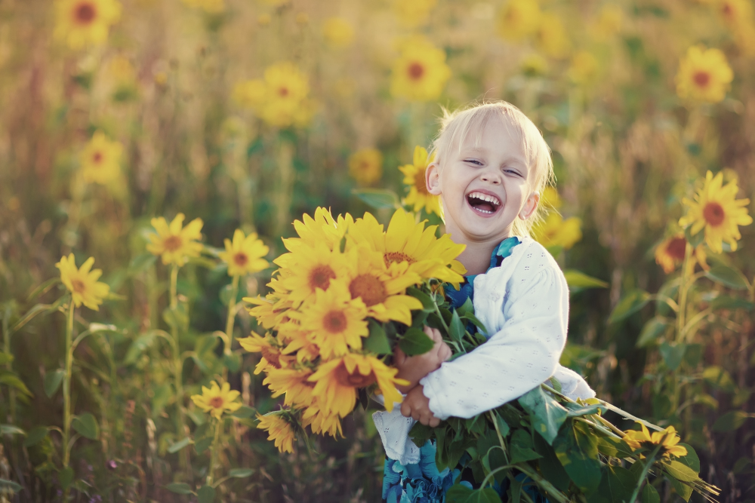
What are your takeaways?
Notes:
Partage

Slide 34

Bandwidth (recommended to turn off other applications)
Mic (unmute to ask questions, comment or share thoughts)
Raise hand (virtually ask to express your thoughts)
Cameras (activated, unless you are dealing with other priorities)
Exit full screen and choose “Side-by-side: Gallery” option (to optimize the view)
Chat (anytime)
Reactions (recognize what they are saying)
Take notes (it helps keeping the attention and reinforces the retention)
Notes:
Tester le clavardage en posant une question: dans quelle région, ville ou quartier êtes-vous en ce moment
Tester la lever des mains avec tous les participants ainsi que les réactions
Ne pas expliquer les 2 derniers, ce sera fait plus tard quand on aura besoin

Slide 35

Bandwidth (recommended to turn off other applications)
Mic (unmute to ask questions, comment or share thoughts)
Raise hand (virtually ask to express your thoughts)
Cameras (activated, unless you are dealing with other priorities)
Chat (anytime)
Reactions (recognize what they are saying)
Take notes (it helps keeping the attention and reinforces the retention)
Notes:
Tester le clavardage en posant une question: dans quelle région, ville ou quartier êtes-vous en ce moment
Tester la lever des mains avec tous les participants ainsi que les réactions
Ne pas expliquer les 2 derniers, ce sera fait plus tard quand on aura besoin

