Slide 1
Ice breakers
Virtual activities to start your meetings or training sessions
Activities imagined by
Jorj Helou
Leadership Awakener
Please share…
Get inspired and remember to adapt the activities to your context and to your needs

Slide 2
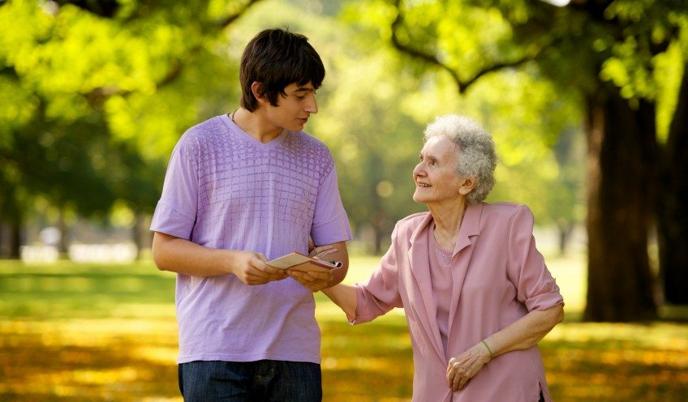
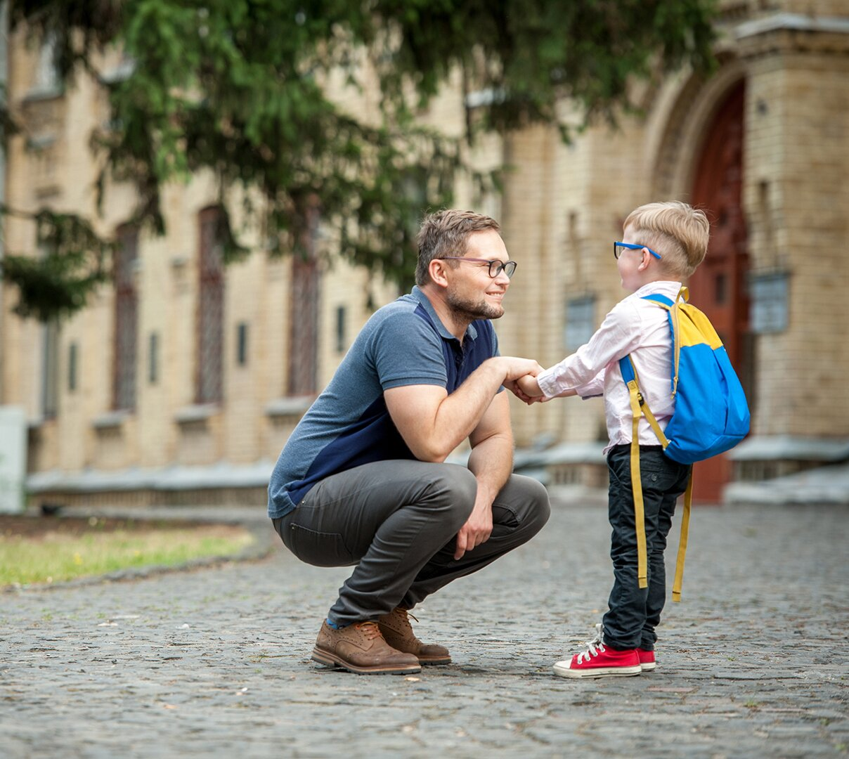
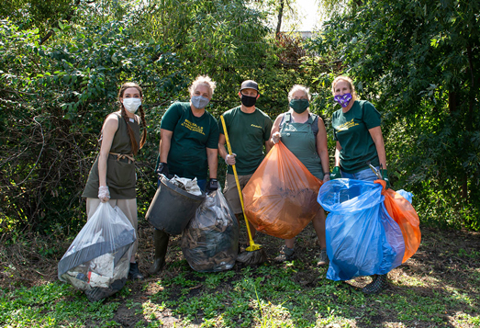
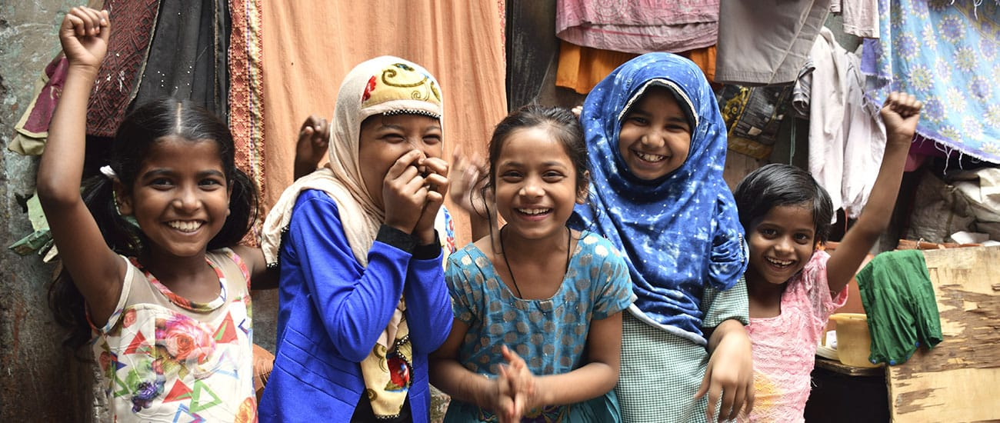
Name an emotion, a value or an inspiration that one of these photos brings out
1
2
3
4

Slide 3
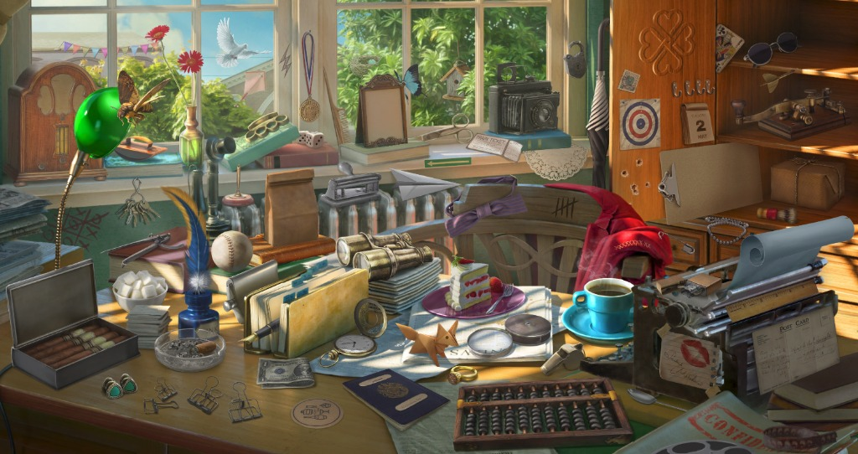
Choose an object and tell us why you made that choice

Slide 4
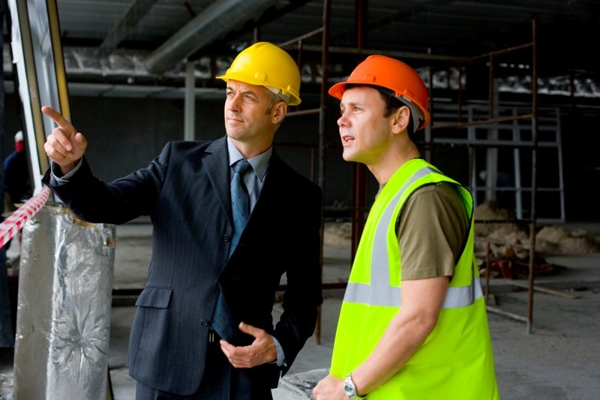
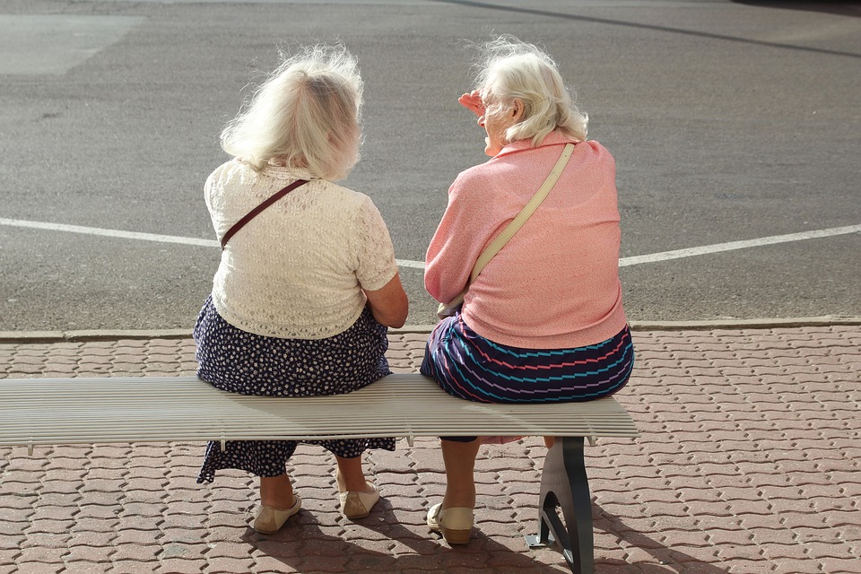
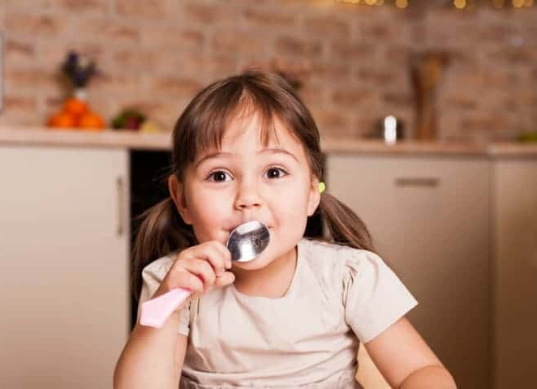
A
B
C
D
E
F
G
H
What are they saying? What are they thinking of?

Slide 5
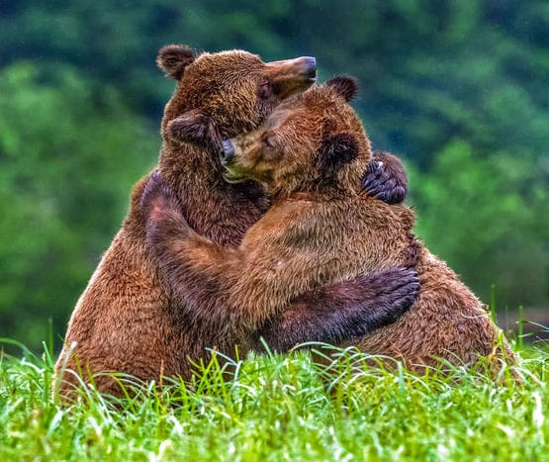
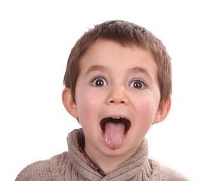
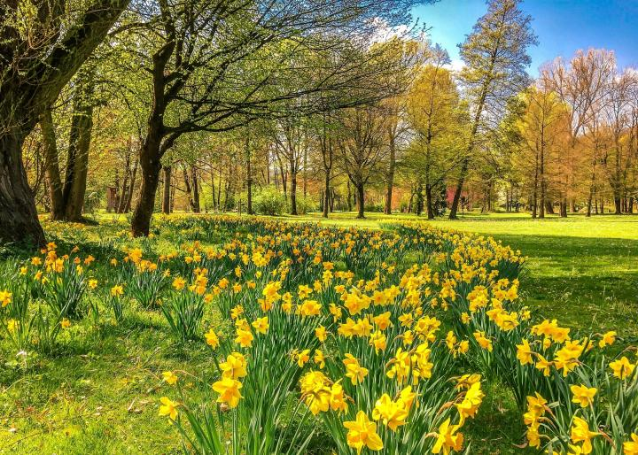
Which picture is the most representative of your mood today?

Slide 6
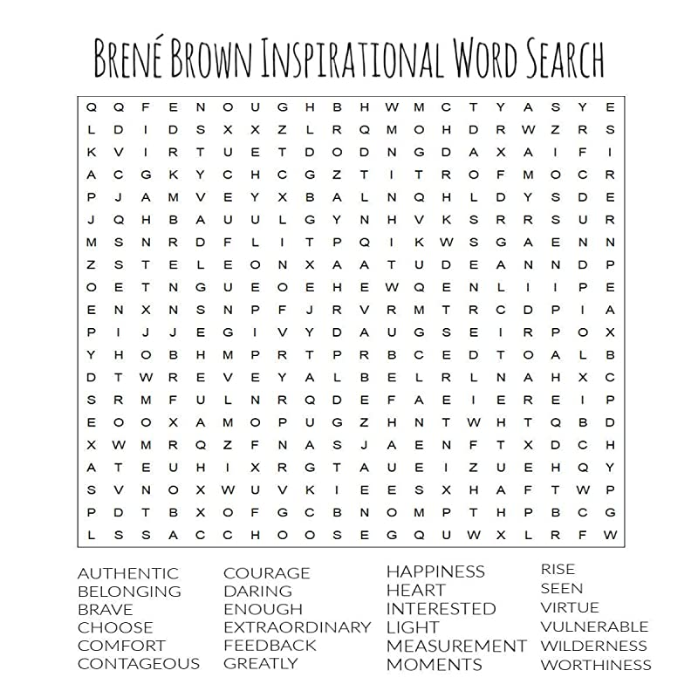
CONTAGIOUS
Notes:
Use the annotation tools

Slide 7
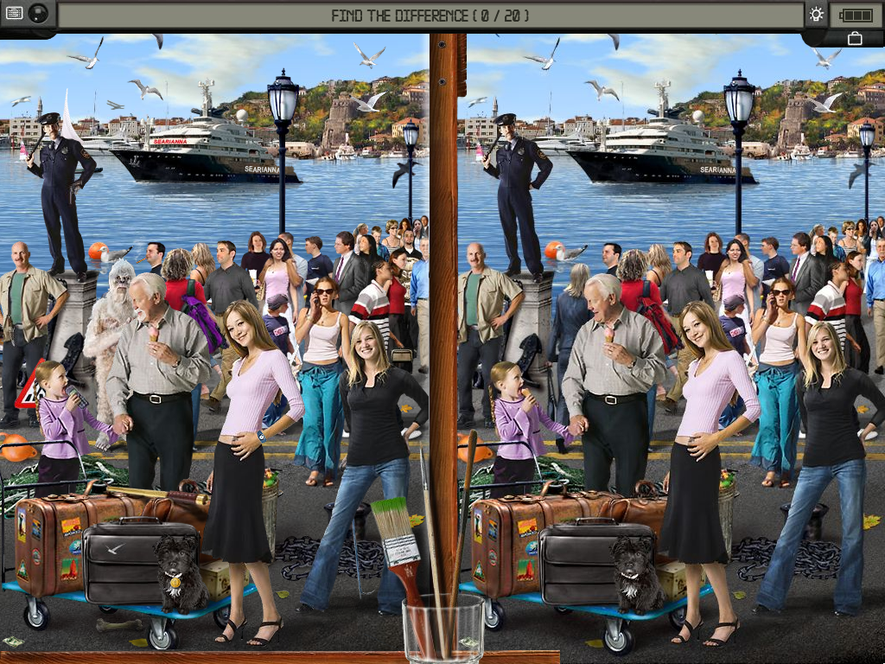
find 20 differences
Notes:
Use the annotation tools

Slide 8
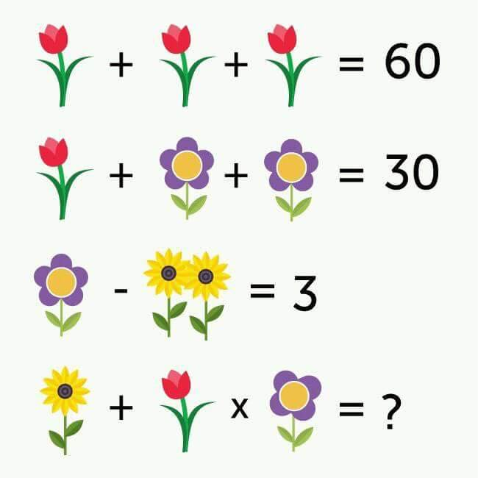
Can you solve it?
Notes:
One red tulip = 20.
A purple flower with 5 petals = 5 (so a purple flower with 4 petals = 4)
2 sunflowers = 2 (so one sunflower = 1).
The last line: there is 1 sunflower (therefore 1) + a red tulip (therefore 20) x a purple flower with 4 petals (therefore 4). 1 + 20x4.
We must first multiply 20x4 and add 1. This gives 81.

Slide 9
Which quote inspires you the most today and why?
"Let excellence be your brand... Doing the right thing, even when nobody knows you're doing the right thing, will always bring the right thing to you.“ – Oprah Winfrey
"Teamwork begins by building trust. And the only way to do that is to overcome our need for invulnerability." – Patrick Lencioni
"Talent wins games, but teamwork and intelligence win championships." – Michael Jordan
“The courage to be vulnerable is not about winning or losing, it’s about the courage to show up when you can’t predict or control the outcome.” – Brené Brown
"It is literally true that you can succeed best and quickest by helping others to succeed.“ – Napolean Hill

Slide 10
If children live with criticism,
they learn to condemn.
If children live with hostility,
they learn to fight.
If children live with fear,
they learn to be apprehensive.
If children live with pity,
they learn to feel sorry
for themselves.
If children live with ridicule,
they learn to feel shy.
If children live with jealousy,
they learn to feel envy.
If children live with shame,
they learn to feel guilty.
If children live with encouragement, they learn confidence.
If children live with tolerance,
they learn patience.
If children live with praise,
they learn appreciation.
If children live with acceptance,
they learn to love.
If children live with approval,
they learn to like themselves.
If children live with recognition,
they learn it is good to have a goal.
If children live with sharing,
they learn generosity.
If children live with honesty,
they learn truthfulness.
If children live with fairness,
they learn justice.
If children live with kindness and consideration, they learn respect.
If children live with security,
they learn to have faith in themselves and in those about them.
If children live with friendliness,
they learn the world is a nice place in which to live.
- By Dorothy Law Nolte.
Which part do you like most and why?
Notes:
Open mics

Slide 11
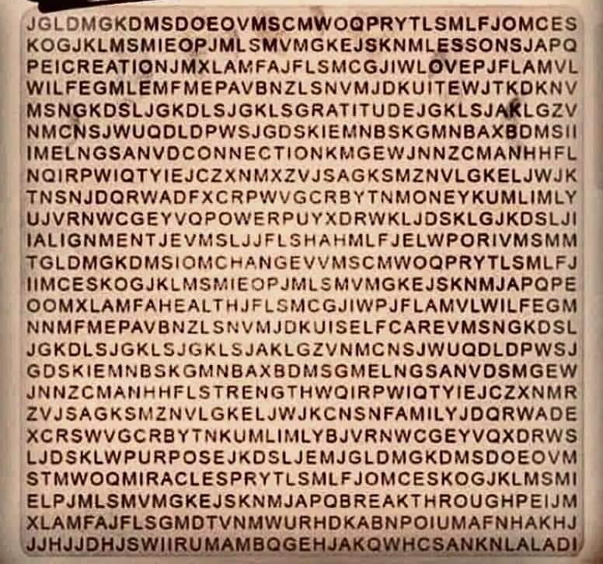
What’s the first word you see and how does it inspire you today?

Slide 12
Describe successful virtual leadership in words and graphics…!
Notes:
Use the annotation tools

Slide 13
Think of three statements about themselves (A, B & C): 2 must be true, and 1 must be false
The more unique or interesting the statement, the better! (recommended to avoid common statements like “I like ice cream”)
Each person shares the three statements (in any order)
All vote which statement is false in chat (A, B or C)
Person reveals which one was the lie
Notes:
Use the annotation tools

Slide 14
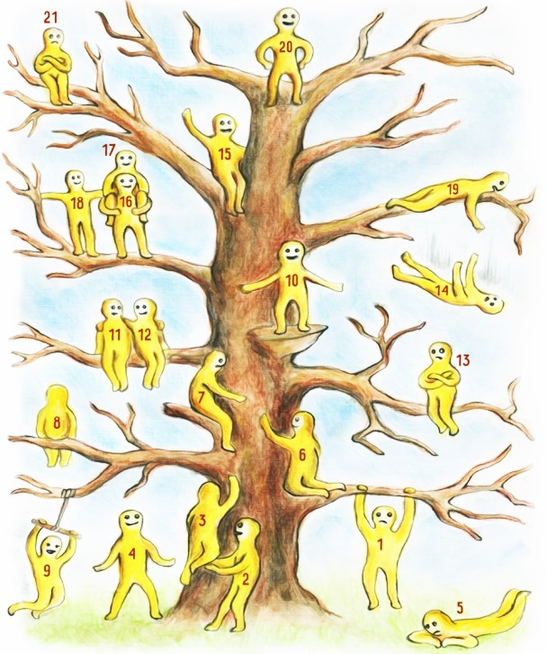
Which of the "blob" characters represents you the most in this period and why?
(inspired by Pip Willson's model)
blob 1 dares, hesitates and worries
blob 2 supports and stays secure
blob 3 gets a boost to take the first steps
blob 4 is optimistic and plans his long-term vision
blob 5 is disconnected and lets the time pass
blob 6 needs care and connection
blob 7 decides to be kind
blob 8 changes perspective, meditate or dream
blob 9 enjoys life
blob 10 celebrates success and seeks recognition
blobs 11 and 12 take the time to appreciate a friendship or a love
blob 13 is dissatisfied because he is dissatisfied
blob 14 stumbled; he should have taken it differently
blob 15 savors the moment and is not in a hurry to going further
blobs 16, 17 and 18 work as a team, support and help each other
blob 19 did everything he could to help
blob 20 is proud of achieving his goal and keeps an eye on the future
blob 21 is disappointed despite his progress

Slide 15
Create an analogy
Choose an object
Describe its characteristics, faults, benefits, dangers, uses, etc.
Make a link with the topic of this meeting

Slide 16
Show us the view out your window… What do you appreciate?

Slide 17
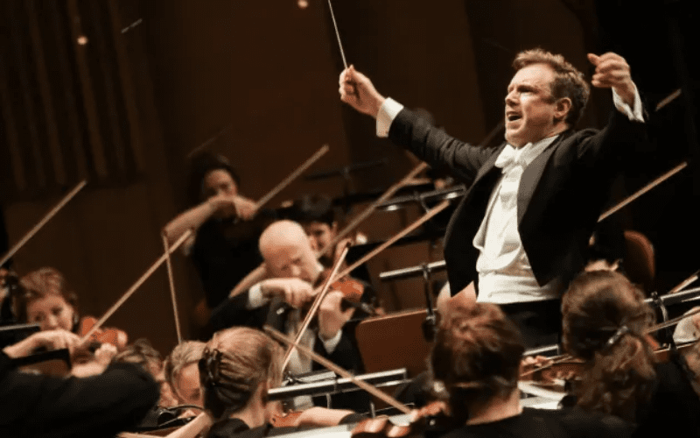
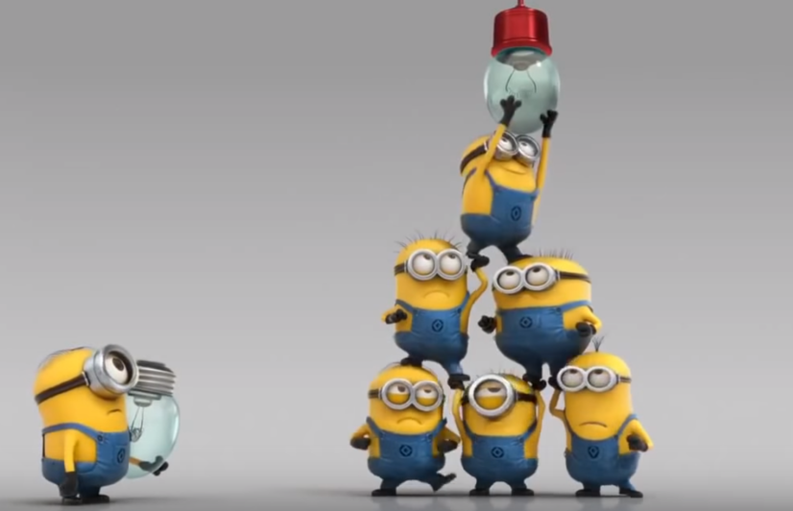
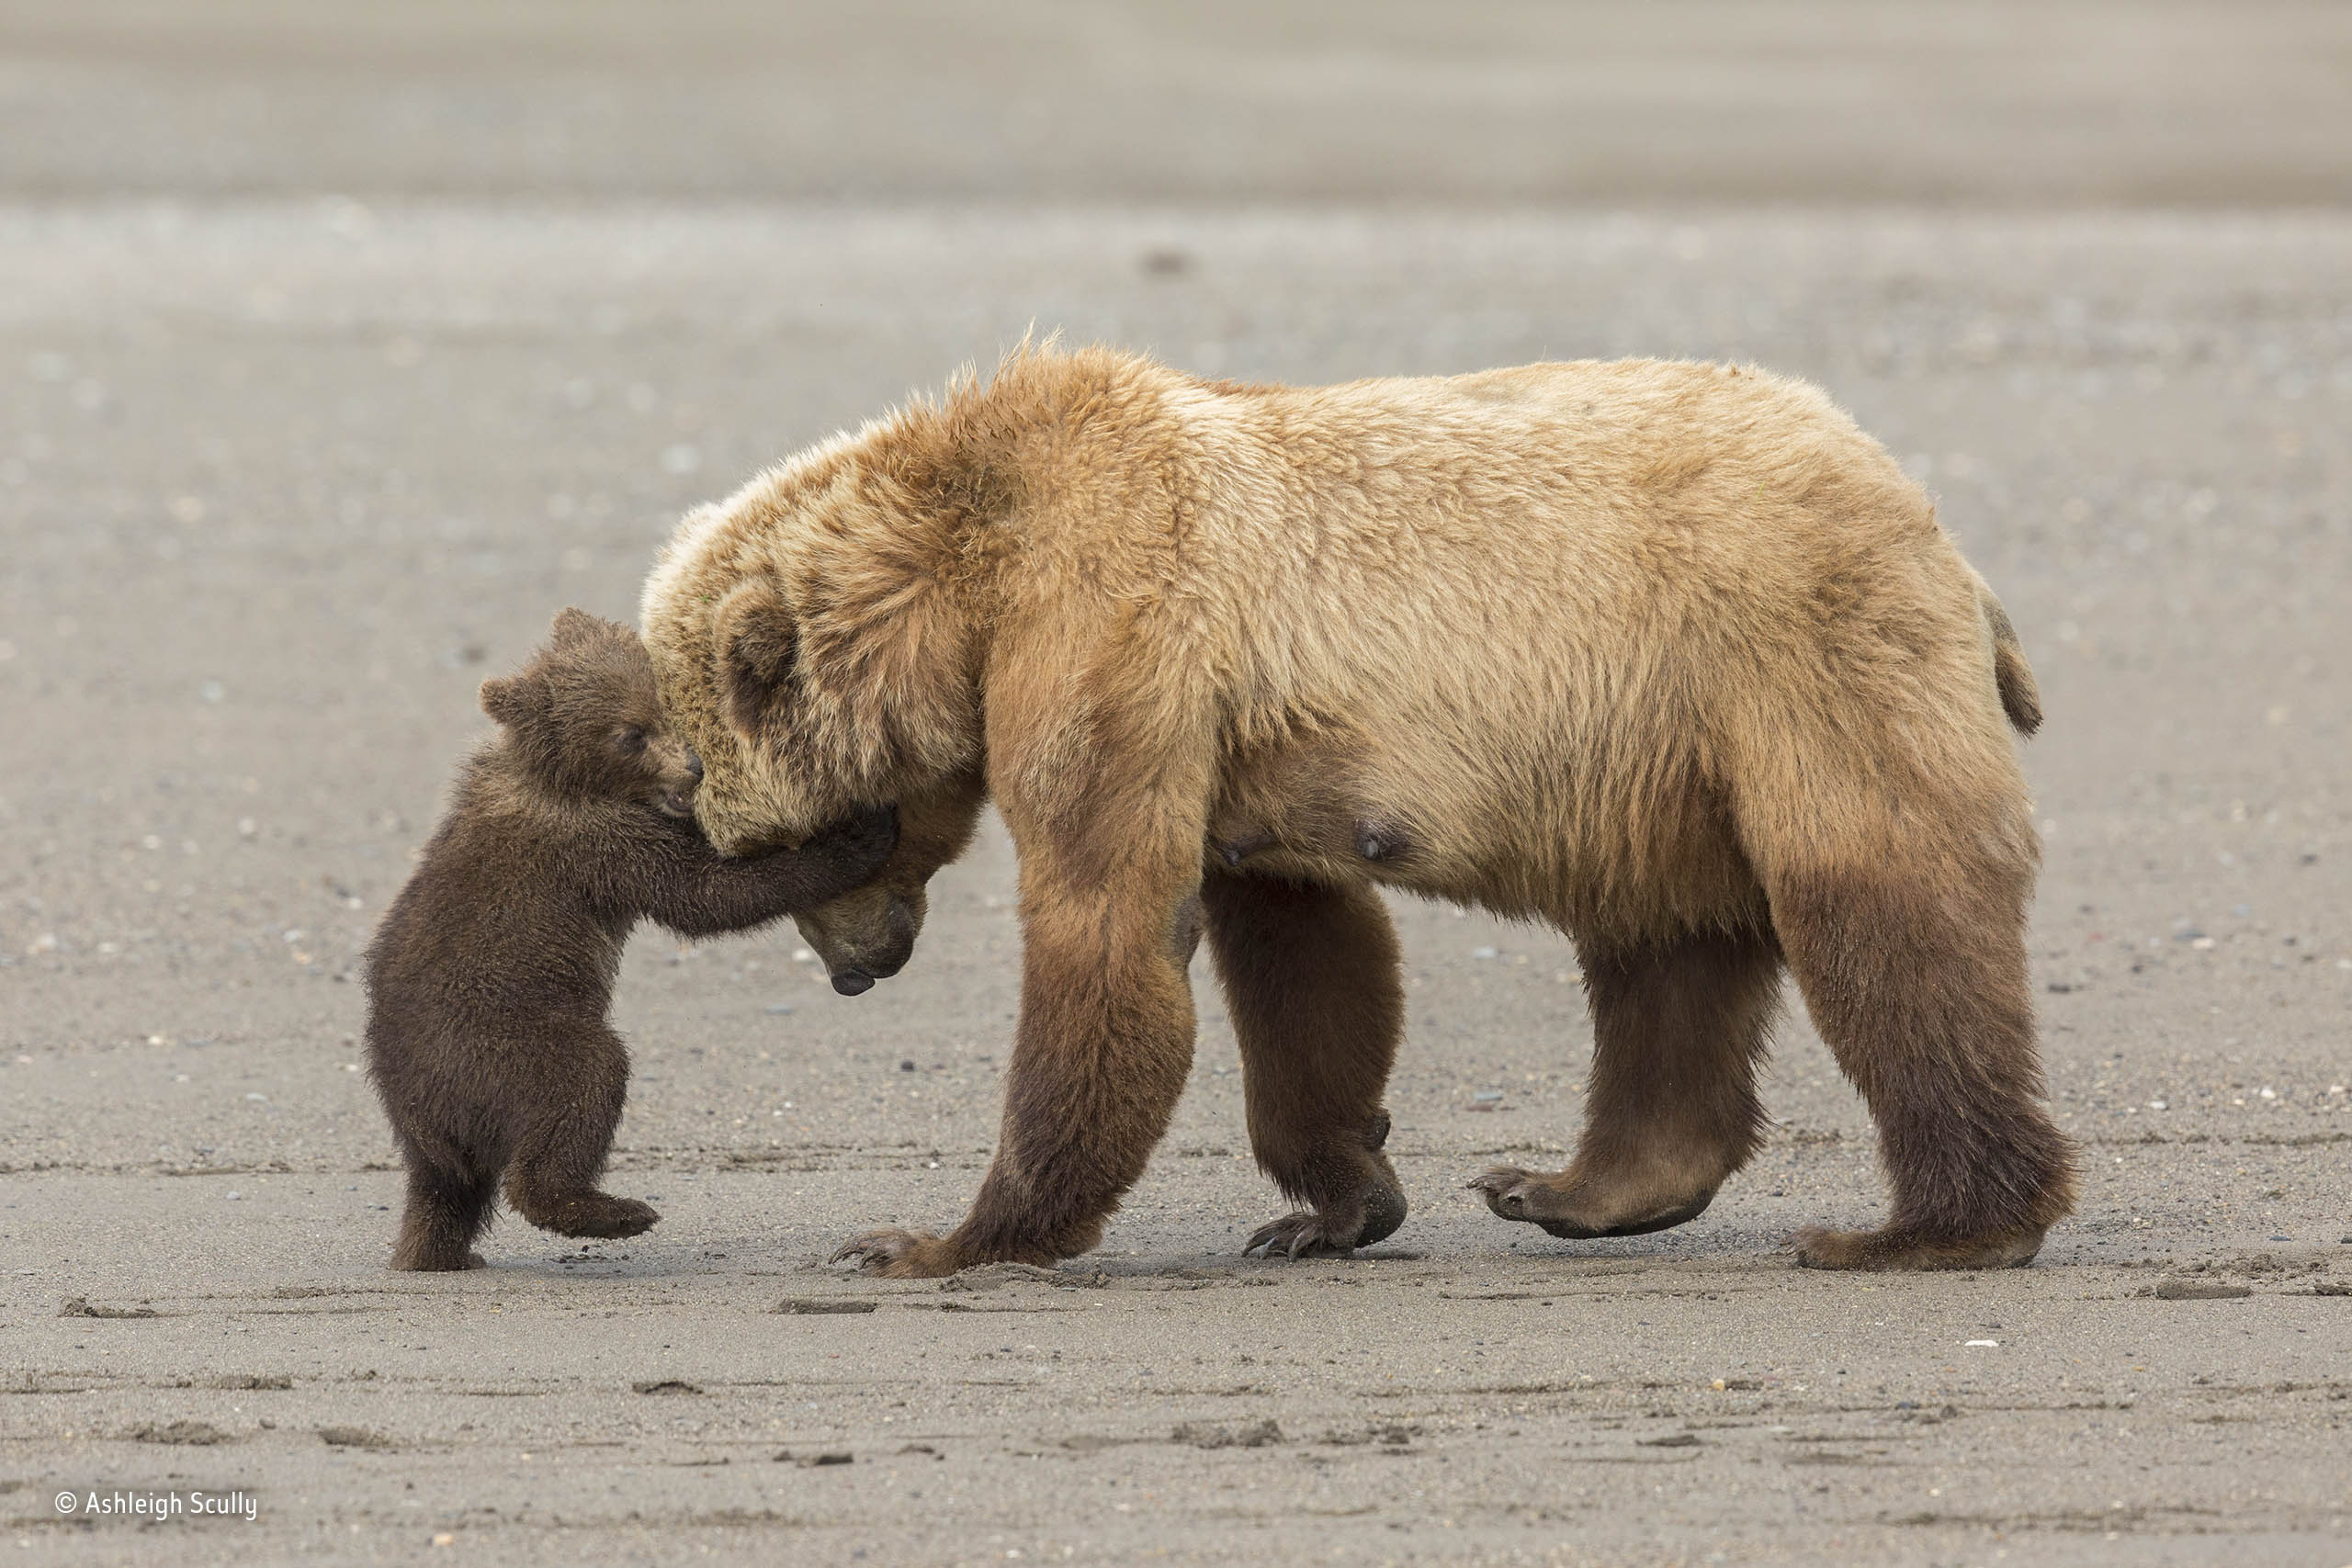
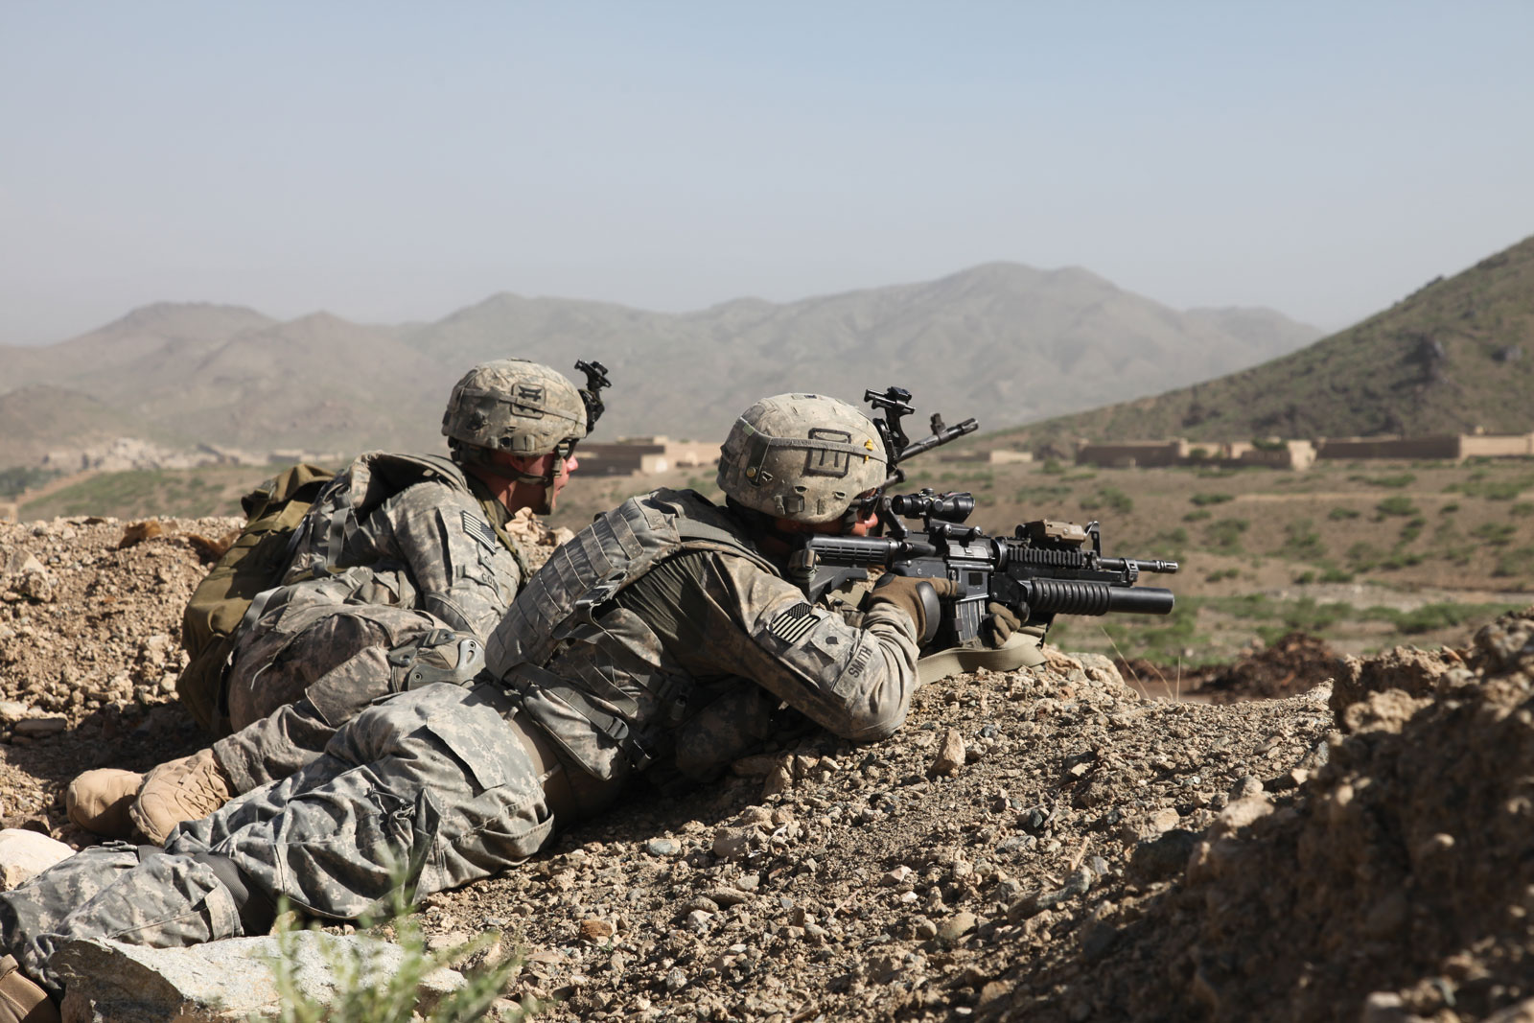
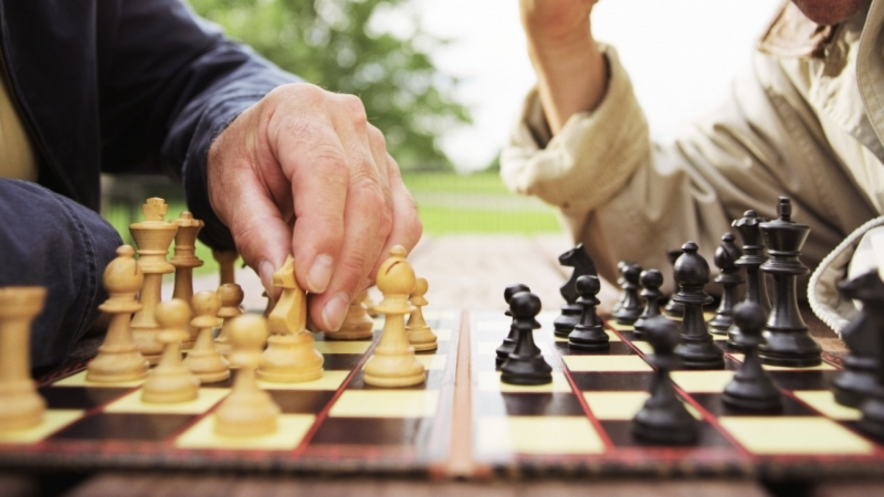
Influencing is like __________ , it’s important to __________ .
Be inspired by the photos and complete the following sentences with an analogy…
1
2
3
4
5
6

Slide 18
By chat, in private mode, share with the facilitator a surprising statement about you
The facilitator will read the statements without mentioning the name
Guess who?

